Slide 1
Warning: Carefully Follow All Instructions
Changes and Rearranges in Iowa Civil Jury Instructions
Josh Strief

Slide 2
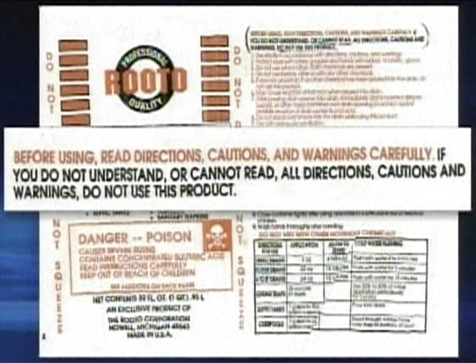
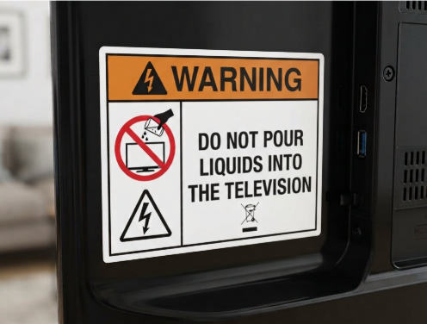
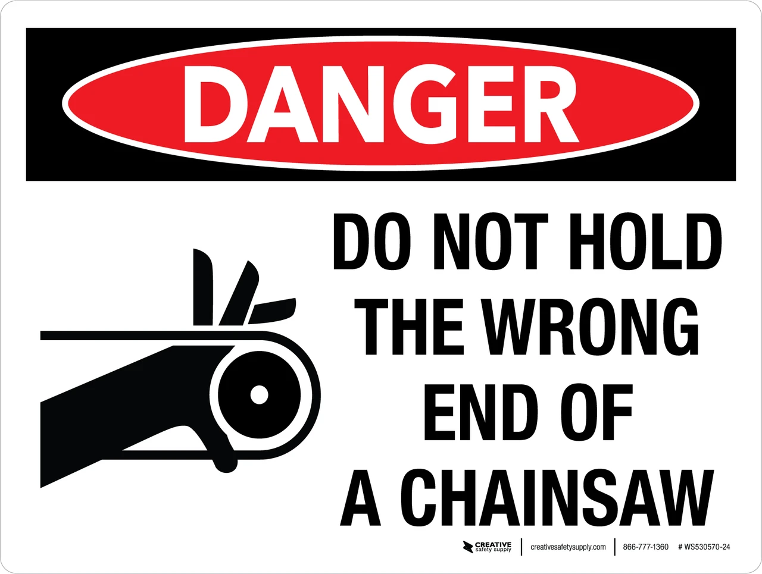
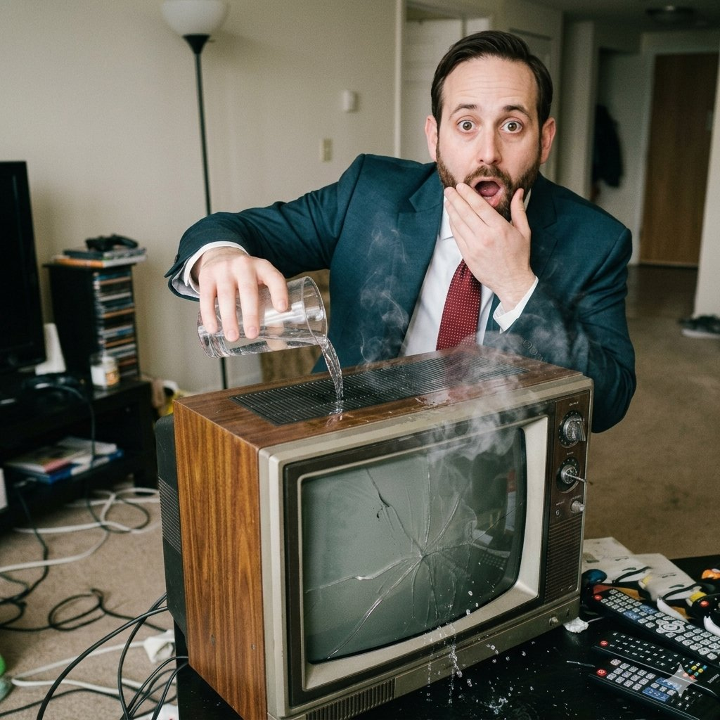
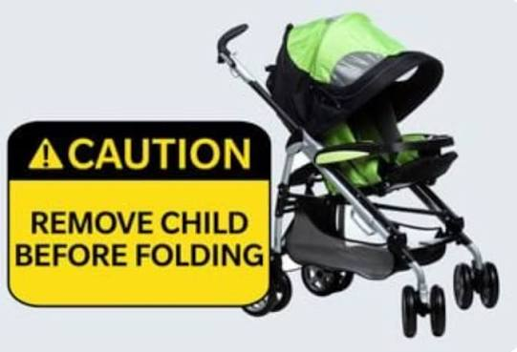

Slide 3
LEGAL DISCLAIMER
Images used during this presentation may bear an uncanny likeness to real people, including some conference attendees. Any such resemblance is purely coincidental, inadvertent, and attributable solely to algorithmic selection by AI of a person likely* to engage in such activities.
*Or completely unlikely – who knows how AI actually works

Slide 4

Roadmap
What are Jury Instructions
Pre-Trial Use of Jury Instructions
Jury Instructions During Trial
Changes and Rearranges – New and Updated Jury Instructions

Slide 5
What are Jury Instructions?
Instructions given to a jury by the Court that explain the law.
The purpose of jury instructions is to give the law to the jury in language they can understand.
Different Uses During Trial:
  Explaining the Trial Process
  Explaining Juror Duties
  Explaining Legal Principles
When Given:
  Before Jury Selection
  Before Opening Statements
  Before Closing Arguments
How Created:
  Court
  Litigants

Slide 6

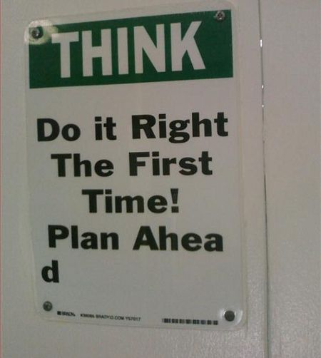
Pre-Trial Use of Jury Instructions
Plan Ahead! Reference jury instructions early in the case
  Elements of Claims
  Identify Legal Gaps
  Reporting
  Discovery

Slide 7
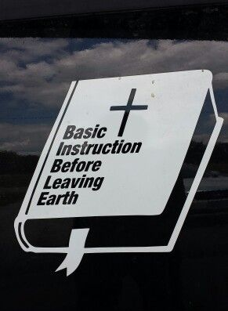

Pre-Trial Use of Jury Instructions
Where to find jury instructions:
  Iowa Civil Jury Instructions
  Past cases at your firm
  Westlaw/Lexis/FastCase/Verdict Database to identify other cases with instructions
  Legal research of issues

Slide 8
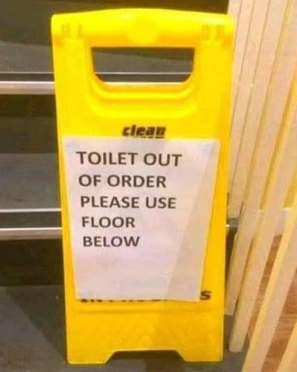
Jury Instructions During Trial
DRAFTING TIPS:
Make it easy for the Judge to use your instructions!
  Word version
  Order of instructions
  First isn’t the worst
  Good drafting principles

Slide 9
Jury Instructions During Trial
Iowa Rule of Civil Procedure 1.924
  Court must provide counsel with preliminary draft of instructions it expects to give on all controversial issues – not part of record
  Before closing arguments, court shall give each counsel a copy of instructions in final form, noting this fact for the record and giving reasonable time for counsel to make objections
  Objections shall be made and ruled on before closing arguments.

Slide 10
Jury Instructions During Trial
Iowa Rule of Civil Procedure 1.924 Continued:
  Objections to giving or failing to give any instructions must be made in writing or dictated into the record outside jury’s presence specifying the matter objected to and the grounds for the objection
  Even timely objection to jury instructions will not avoid waiver of error if objection is too vague – must be specific enough to alert court to basis of complaint so court may correct it – Olson v. Sumpter, 728 N.W.2d 844 (Iowa 2007).
    Example: “Objection, the evidence is insufficient to submit fault to the jury.” -- inadequate to alert district court to more specific contention raised on appeal. Instead, must specify portion of instruction lacking evidentiary support and particular actual deficiency.

Slide 11
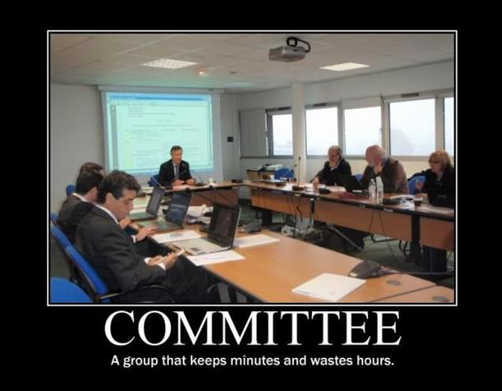
Changes and Rearranges
ISBA Jury Instruction Committee
  Civil and Criminal Jury Instructions
  Wide variety of practice areas rep’d
  Process

Slide 12
Changes and Rearranges – Scope of Liability
Difficult concept since introduction
3 Changes in July 2025:
  Uses simpler language
  Format changed– first paragraph states rule, second paragraph clarifies what conduct is included or excluded
  Re-introduced “foreseeability” as a concept

Slide 13
Changes and Rearranges – Scope of Liability
Old Version:
700.3A Scope of Liability – Defined. You must decide whether the claimed harm to plaintiff is within the scope of defendant's liability. The plaintiffs claimed harm is within the scope of a defendant's liability if that harm arises from the same general types of danger that the defendant should have taken reasonable steps [or other tort obligation] to avoid.
Consider whether repetition of defendant's conduct makes it more likely harm of the type plaintiff claims to have suffered would happen to another. If not, the harm is not within the scope of liability.
New Version:
700.3A Scope of Liability – Defined. Harm is within the scope of a party’s liability when it is among the type of reasonably foreseeable harms that made the party’s conduct negligent.
If repeating the defendant’s conduct would make it more likely for another person to suffer the same type of harm claimed by plaintiff, then the harm is foreseeable and within the scope of defendant’s liability. If defendant’s conduct merely places plaintiff in a situation where plaintiff sustains injury from an unrelated act or event, the claimed harm is not within the scope of defendant’s liability.

Slide 14
Changes and Rearranges – Dram Shop
Lots of changes to Iowa Code § 123.92
Complete re-write of Dram Shop Instructions in Chapter 1300
Note: Committee purposefully left phrase “visibly intoxicated” undefined

Slide 15
Changes and Rearranges – Premises Liability
Removing “Doody” From the Premises Liability Instruction
900.6 - Known or Obvious Condition
Comment Change – current Known or Obvious Condition not given if comparative fault alleged
If comparative fault – Known or obvious is a factor showing comparative fault of plaintiff. Does NOT negate possessor of land’s duty, so doesn’t get standalone instruction.

Slide 16

Changes and Rearranges - Employment
Employment Rights Instructions – Wrong End of the Chainsaw?
Changes to 12 different instructions so far in last few years
More changes likely but getting agreement difficult

Slide 17
Questions?
Contact Info:
joshua.strief@elversonlaw.com
Office: 515-243-1914

