Slide 1
Request for Admissions: Samurai Sword or Wet Noodle?
James Bryan
Whitfield & Eddy, P.L.C.

Slide 2
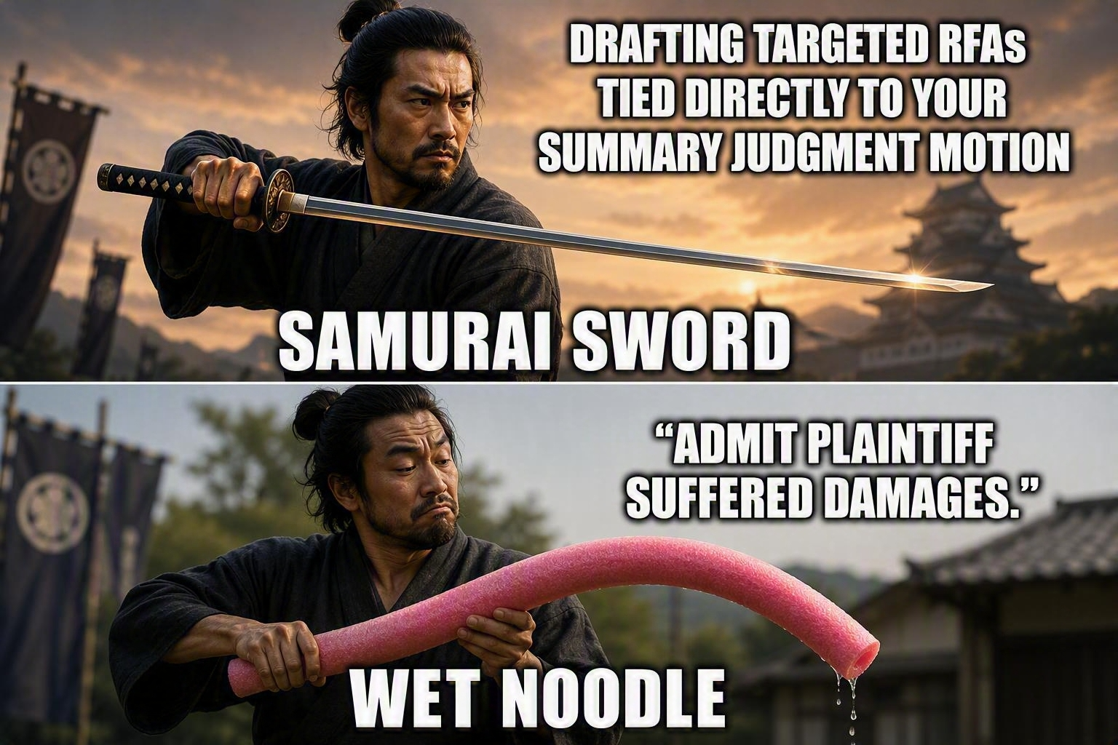

Slide 3
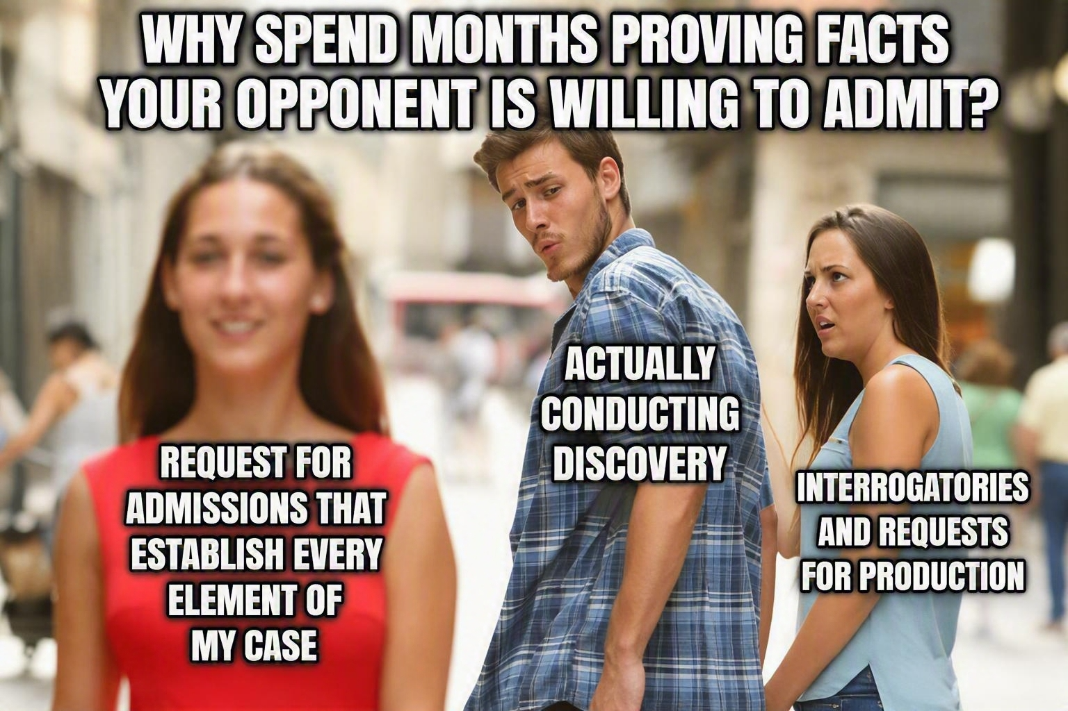

Slide 4
Federal

Slide 5
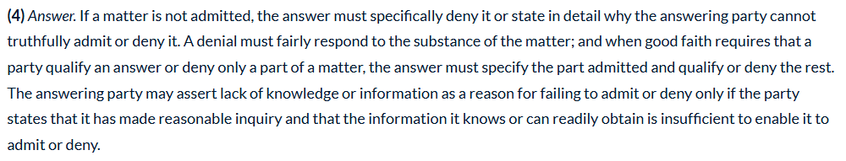
Federal Rules of Civil Procedure
Rule 36 Requests for Admission

Slide 6
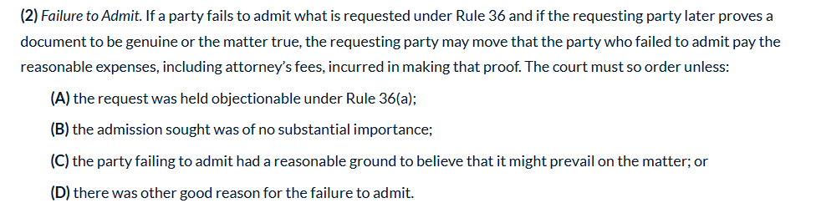
Federal Rules of Civil Procedure
Rule 37. Failure to Make Disclosures or to Cooperate in Discovery; Sanctions

Slide 7
"Reasonable Inquiry" Factors
Access to the information
Efforts actually taken
Level of detail in the response
Proportionality/burden on responding party
Timing and discovery posture
Good faith

Slide 8
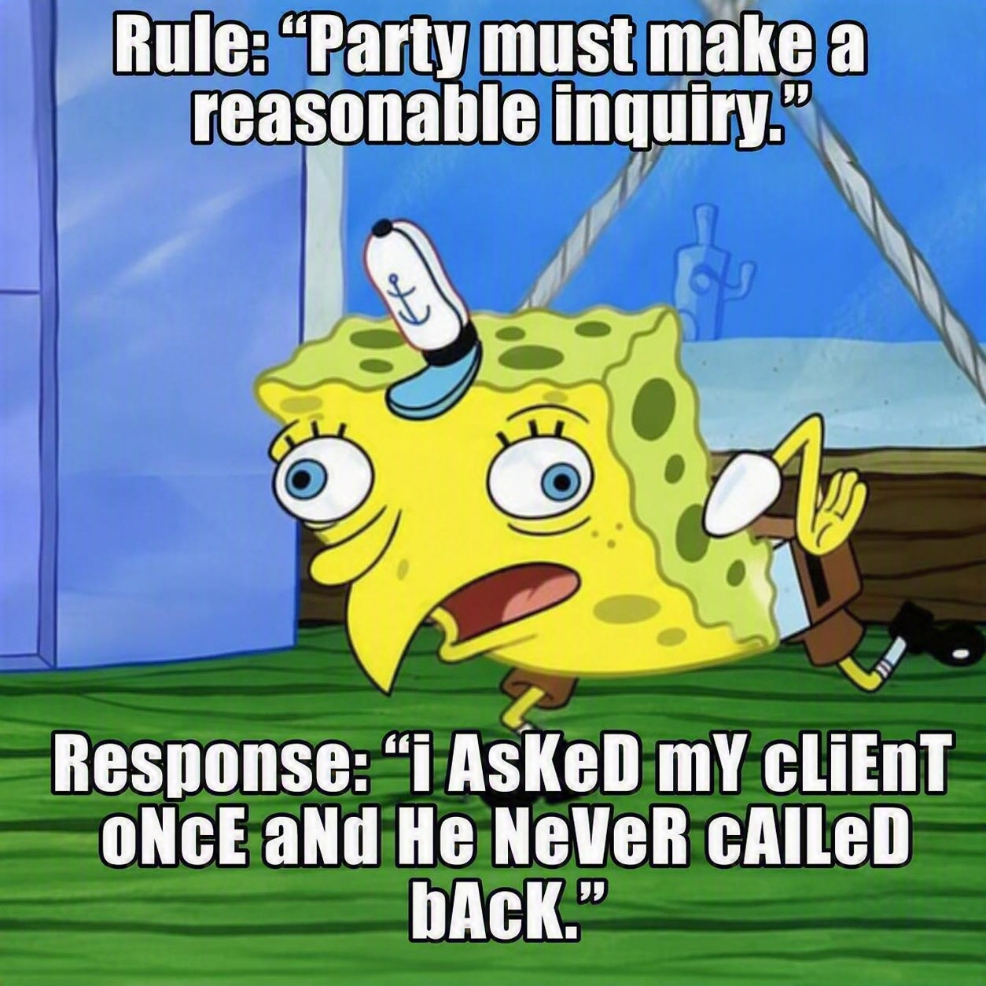

Slide 9
Lessons from Federal Cases

Slide 10
Asea: The Original "Nice Try"
Response to Request for Admission:
"We cannot admit or deny. Investigation continues."
Court's Response:
"That isn't enough.“
Holding: Reasonable inquiry means actual investigation.
Lesson: You must tell the court what inquiry was made.

Slide 11
Asea, Inc. v. S. Pac. Transp. Co., 669 F.2d 1242 (9th Cir. 1981).
Facts:
  Asea sold electric transformers
  During transport from Sweden to Los Angeles, the transformer shifted resulting in substantial damage
  Asea filed an action for damages and served a series of RFA’s on the railroad
  The Railroad replied to 18 requests stating “Answering party cannot admit or deny. Said party has made reasonable inquiry. Information known or readily obtainable to this date is not complete. Investigation continues.”
  Each RFA had an interrogatory which asked if the RR’s response was not an unqualified admission, they should state facts, documents and witnesses upon which the response was based – RR answered saying these answers were “not applicable”

Slide 12
Asea, Inc. v. S. Pac. Transp. Co., 669 F.2d 1242 (9th Cir. 1981).
Facts:
  Asea believed the RR had info needed to admit or deny and moved to have the requests admitted
  RR claimed the responses were proper under Rule 36(a) because they did not have firsthand information
  The district court granted Asea’s motion to order the matters admitted
  The RR argued the sanction for failure to make reasonable inquiry is an award of expenses incurred in proving the fact at trial, rather than deeming the matter admitted

Slide 13
Asea, Inc. v. S. Pac. Transp. Co., 669 F.2d 1242 (9th Cir. 1981).
Issues:
Did the district court err in deeming certain matters admitted under FRCP 36(a) due to the RR’s failure to adequately respond to RFAs?
What must a party do to properly respond to RFAs under FRCP 36 when it lacks immediate knowledge of the facts?
Holdings:
No.
Make reasonable inquiry into information that is readily obtainable.

Slide 14
Asea, Inc. v. S. Pac. Transp. Co., 669 F.2d 1242 (9th Cir. 1981).
Analysis:
  The court noted that the appropriate penalty for failing to make reasonable inquiry is unclear (deeming admitted vs. award of expenses incurred in proving the fact at trial)
  A response which fails to admit or deny a proper request for admission does not comply with FRCP 36(a) if the answering party has not made reasonable inquiry
  If a requesting party feels a reasonable inquiry was not met, they may move to determine the sufficiency of an answer and either compel a proper response or ask for the order to be admitted
  The district court has ultimate/wide discretion on the decision

Slide 15
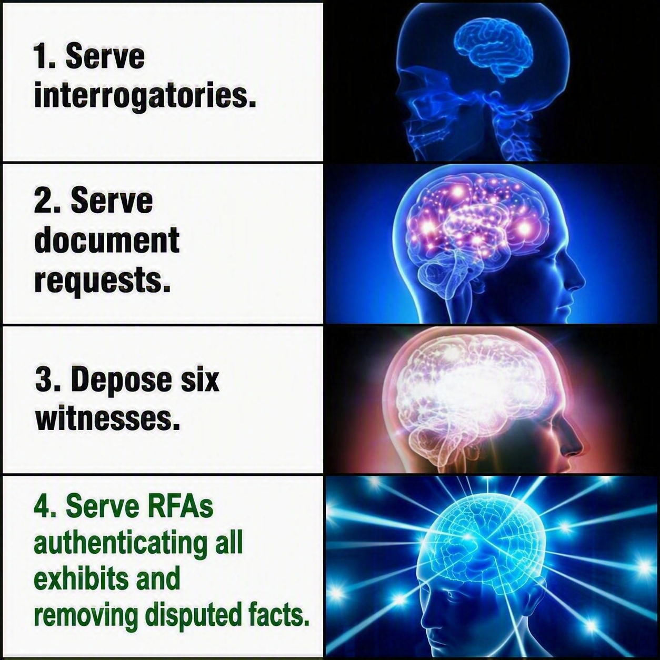

Slide 16
How Can I Verify What I Don’t Possess?
Request for Admission: “Admit or deny the document is a true and correct copy?
Response: “I don’t have the original.”

Slide 17
ADC Telecommunications, Inc. V. Telect, Inc., 143 F.R.D. 214 (Dist. Of Minn. 1992).
Defendant seeks to have plaintiff admit or deny:
  A copy of the patent at issue is a true and correct copy
    Plaintiff objected because they were unable to admit or deny because they did not have the original copy with which to compare the copy received.
    Court held that without access to the original, it is not possible or prudent to admit or deny that a copy is a true copy. Defendant was advised to rephrase the request.
  Plaintiff's product infringes upon Defendant's patent, specifically stating that Plaintiff is to presume that Defendant's patent is available.
    Plaintiff objected because the facts known to them contradict this presumption.
    Court held that the plaintiff's objection was not an answer, and that they were required to submit a sufficient answer.

Slide 18
How Many Requests for Admission is Too Many?
5?
10?
20?
50?
373?

Slide 19
Lakehead Pipe Line Company v. American Home Assur. Co., 177 F.R.D. 454 (Dist. Of Minn. 1997).
Defendants served Plaintiffs with 373 RFAs, most accompanied by an interrogatory.
  Each RFA and interrogatory had a response keeping with the directives of Rule 36.
Defendants sought admissions as to the authenticity of certain documents and accuracy of their interpretation of the content.
  The other party does not have to admit when there is a factual dispute as to the interpretation of the document.
Defendants take issue with Plaintiff's refusal to provide factual basis for their denials.
  Rule 36 does not authorize a court to prospectively render determinations concerning the accuracy of a denial to a RFA.

Slide 20
Requests for Admission: Responding to RFAs by Jim Wagstaffe (last updated March 30, 2026).
If a requesting party has grounds for believing that a response is deficient, the requesting party may move for a judicial determination.
  This motion should not be used to test the accuracy of a denial that fairly meets the requirements of the rule.
  In the case of a denial, the proper course is to prove the inaccuracy of the denial at trial and then move to recover expenses and fees reasonably incurred to prove the truth.
  This motion is infrequently used, likely because the expense and burden of bringing the motion are rarely proportionate to the results.

Slide 21


Slide 22
Strategy for Exploiting Deficient Responses
Creates a deadline for answers
Narrows issues
Standard: at minimum, a party must make inquiry of a third party when there is some identity of interest manifested, such as both being parties to the litigation, a present or prior relationship of mutual concerns, or their active cooperation in the litigation, and when there is no manifest or potential conflict between the party and third party.
Notes:
Michael W. Pinsof, Article: An Insurer's Duty of "Reasonable Inquiry": A Strategy for Exploiting Deficient Responses to Requests for Admission, 4 Stetson J Advoc. & L. 158 (2017).

Slide 23
Strategy for Exploiting Deficient Responses
Evasive responses, claims of lack of knowledge, or failure to sufficiently allege that the responding party has exercised reasonable diligence to obtain readily obtainable information, call for aggressive motion practice.
  Counsel must exercise caution and restraint, especially when practicing in federal court
  In Beasley v. State Farm Mutual the court acknowledged the responses appeared deficient, but still denied the Motion to Compel because the movant failed to confer with opposing counsel and alleged an impassed had occurred prior to filing the motion.
Notes:
Michael W. Pinsof, Article: An Insurer's Duty of "Reasonable Inquiry": A Strategy for Exploiting Deficient Responses to Requests for Admission, 4 Stetson J Advoc. & L. 158 (2017).

Slide 24
A Successful Challenge
If an answer is simply insufficient, with no evidence of bad faith, the court will likely order the respondent to refile sufficient answers.
If an answer is deemed to lack good faith, the court may deem the matter admitted.
A successful motion to ‘Deem Facts as Admitted’ or ‘Documents as Genuine’, can create an opportunity for at least partial summary judgment on a material issue and potential sanctions, as permitted under FRCP 37.
Notes:
Michael W. Pinsof, Article: An Insurer's Duty of "Reasonable Inquiry": A Strategy for Exploiting Deficient Responses to Requests for Admission, 4 Stetson J Advoc. & L. 158 (2017).

Slide 25


Slide 26
Iowa

Slide 27
Iowa Rules of Civil Procedure
Rule 1.510(3) Determining sufficiency of responses.
The party who has requested the admission may move to determine the sufficiency of the answers or objections. Unless the court determines that an objection is justified, it shall order that an answer be served. If the court determines that an answer does not comply with the requirements of this rule, it may order either that the matter is admitted or that an amended answer be served. The court may, in lieu of there orders, determine that final disposition of the request be made at a pretrial conference or at a designated time prior to trial. The provisions of rule 1.517(1)(d) apply to the award of expenses incurred in relation to this motion.
Rule 1.517(1)(d) Award of expenses of motion.
1. If the motion is granted, or if the disclosure or requested discovery is provided after the motion was filed, the court shall, after opportunity for hearing, require the party or deponent whose conduct necessitated the motion or the party or attorney advising such conduct or both of them to pay to the moving party the reasonable expenses incurred in obtaining the order, including attorney’s fees, unless the court finds that the opposition to the motion was substantially justified or that other circumstances make an award of expenses unjust.
2. If the motion is denied, the court shall, after opportunity for hearing, require the moving party or the attorney advising the motion or both of them to pay to the party or deponent who opposed the motion the reasonable expenses incurred in opposing the motion, including attorney’s fees, unless the court finds that the making of the motion was substantially justified or that other circumstances make an award of expenses unjust.
3. If the motion is granted in part and denied in part, the court may apportion the reasonable expenses incurred in relation to the motion among the parties and persons in a just manner.

Slide 28
Iowa's Sanction Problem
The Court Wants:
Willfulness
Fault
Bad faith
The Court Does Not Want:
Minor drafting mistakes
Good faith disputes
Takeaway:
Not every bad answer gets sanctions.

Slide 29
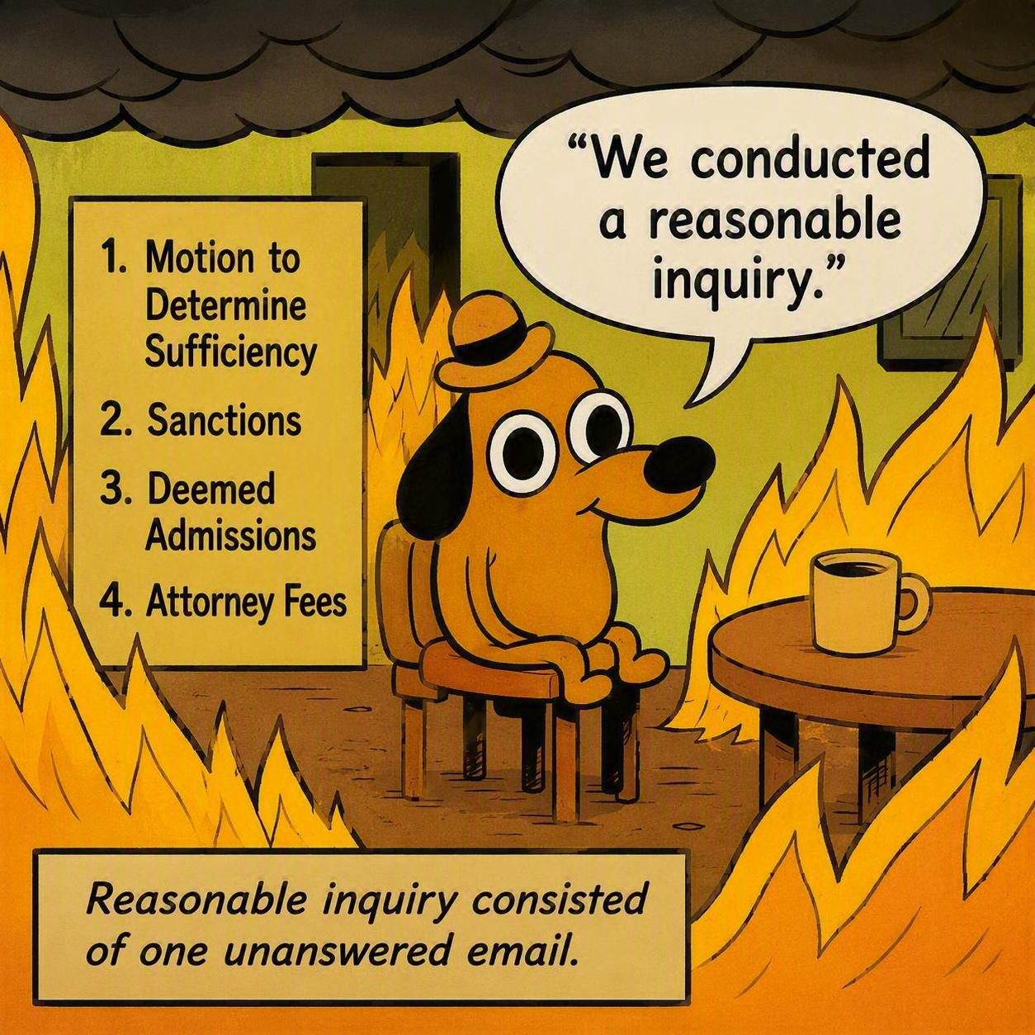

Slide 30
Wade v. Grunden, 743 N.W.2d 872 (Iowa Ct. Of App. 2007).
Rule when sufficiency is challenged:
  Whether there was evidence that the information was attempted to be supplied;
  When was the evidence presented to the other party;
  What is the burden of sanctions.
Standard:
  A party's noncompliance must be due to willfulness, fault, or bad faith.

Slide 31
When a Wrong Answer Isn't Sanctionable
Question:
Can I get fees because the other side denied my request?
Court:
Only if the denial lacked reasonable grounds.
Practice Pointer:
A denial can be wrong without being sanctionable.

Slide 32
In re Eickman Estate, 291 N.W.2d 308 (Iowa 1980).
Plaintiff served requests for admission regarding whether an omission in a land conveyance doc resulted from a mutual mistake or scrivener's error
  Defendants responded that they lacked sufficient information
Holding: The matters were deemed admitted due to defendants' failure to state that a reasonable inquiry had been made
The party must investigate and either admit, deny or explain why after a reasonable inquiry it cannot do either

Slide 33
Postma v. Wedebrand,
Rule 1.517(3)(b) allows sanctions for failure to admit facts unless reasonable grounds exist for the denial.
Plaintiff requested defendant admit three requests that would have disregarded the need for trial
Court held that there was at least a "colorable basis for the denials made" making sanctions improper.

Slide 34
Nebraska

Slide 35
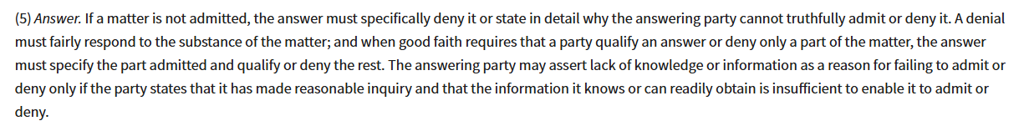
Sufficiency of an Answer
NE R DISC § 6-336(5)

Slide 36
United States Bank Nat'l Ass'n v. Peterson, 823 N.W.2d 460 (Neb. 2012).
The Bank sued 5 guarantors following defaults on underlying notes.
Bank tendered RFAs regarding various facts, including a request to admit the specific amount due on the note for principal, accrued interest, and a prepayment fee.
Guarantor responded, "Defendant does not have the information with which to admit or deny the numbers set out. . ."
Supreme Court of Nebraska held that there is no discretion on how the trial court is to treat an answer that was not an outright denial.

Slide 37
Self-Enforcing not Self-Executing
Neb. Ct. R. Disc. § 6-336 is self-enforcing, it is not self-executing.
A party's failure to make a timely and appropriate response automatically results in an admission of the matter.
To obtain an admission or compel information based on an insufficient response, the party claiming the admission must:
  Provide service of the RFA;
  The service's party's failure to answer or object to the request; and
  Subsequently offer the request for admission as evidence.
Notes:
Lombardo v. Sedlacek, 908 N.W.2d 630 (Neb. 2018).

Slide 38


