Slide 1
Time for a Change?
Updating the Iowa Rules of Civil Procedure
Matt McDermott
Justice, Iowa Supreme Court
Iowa Defense Counsel Association CLE
September 11, 2026
Notes:
Introductions:
Greer and Badding: Co-Chairs
Introduce law clerks
David Denison: Ex officio
Getting an order out announcing the project and listing members

Slide 2
Iowa Code § 602.4201
The supreme court “may prescribe all rules of pleading, practice, evidence, and procedure, and the forms of process, writs, and notices, for all proceedings in all courts of this state, for the purposes of simplifying the proceedings and promoting the speedy determination of litigation upon its merits.”

Slide 3
Some Iowa civil rules history
Submitted for public comment November 1941, effective July 1943
  Many rules replaced (and took the language of) existing statutes on procedural matters
Many subject-specific amendments over the years:
  1950s: Adopted discovery rules
  1960s: Adopted summary judgment rules
  2002: Rules renumbered
  2015: Adopted expedited civil action and amended discovery rules
No comprehensive review of civil rules
Notes:
Federal rules of civil procedure adopted by order of the US Supreme Court December 1937, transmitted to Congress and became effective September 1938. Iowa’s rule were intentionally different. Didn’t adopt all the same rules or the same language. In some cases Iowa intended to follow the federal rule but opted for its own language.

Slide 4
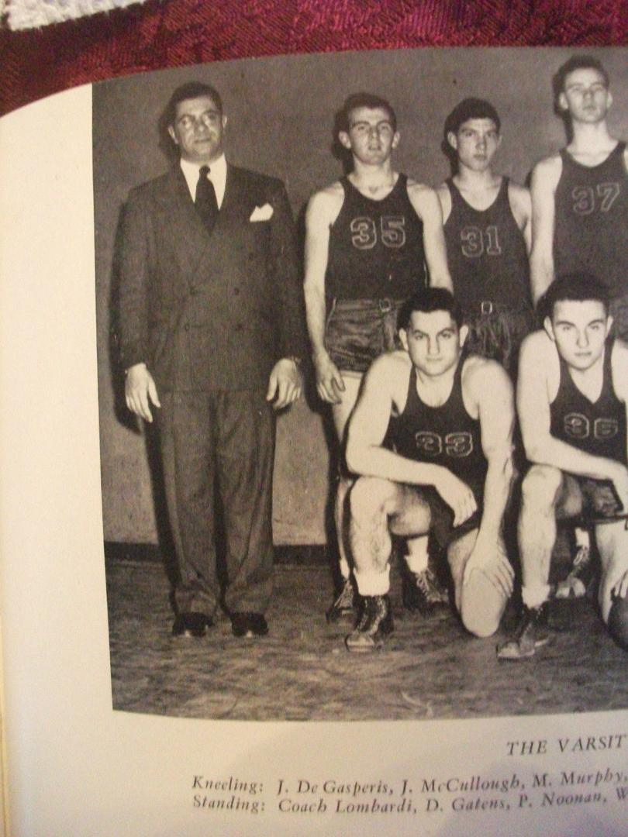
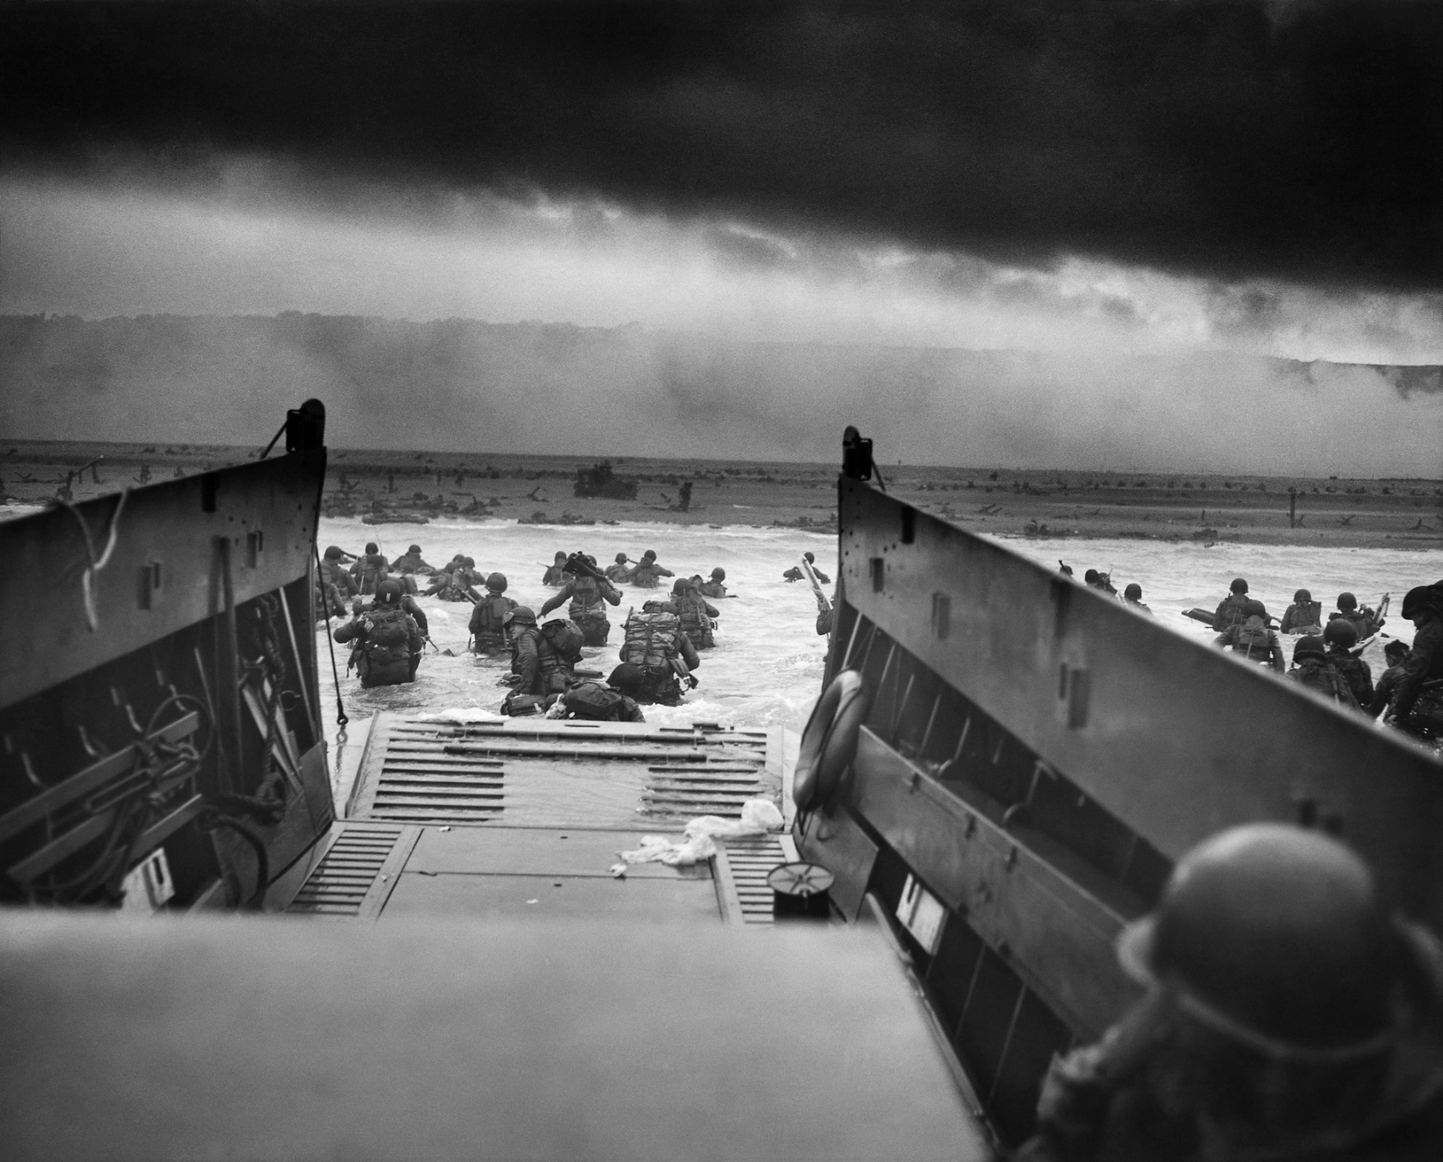
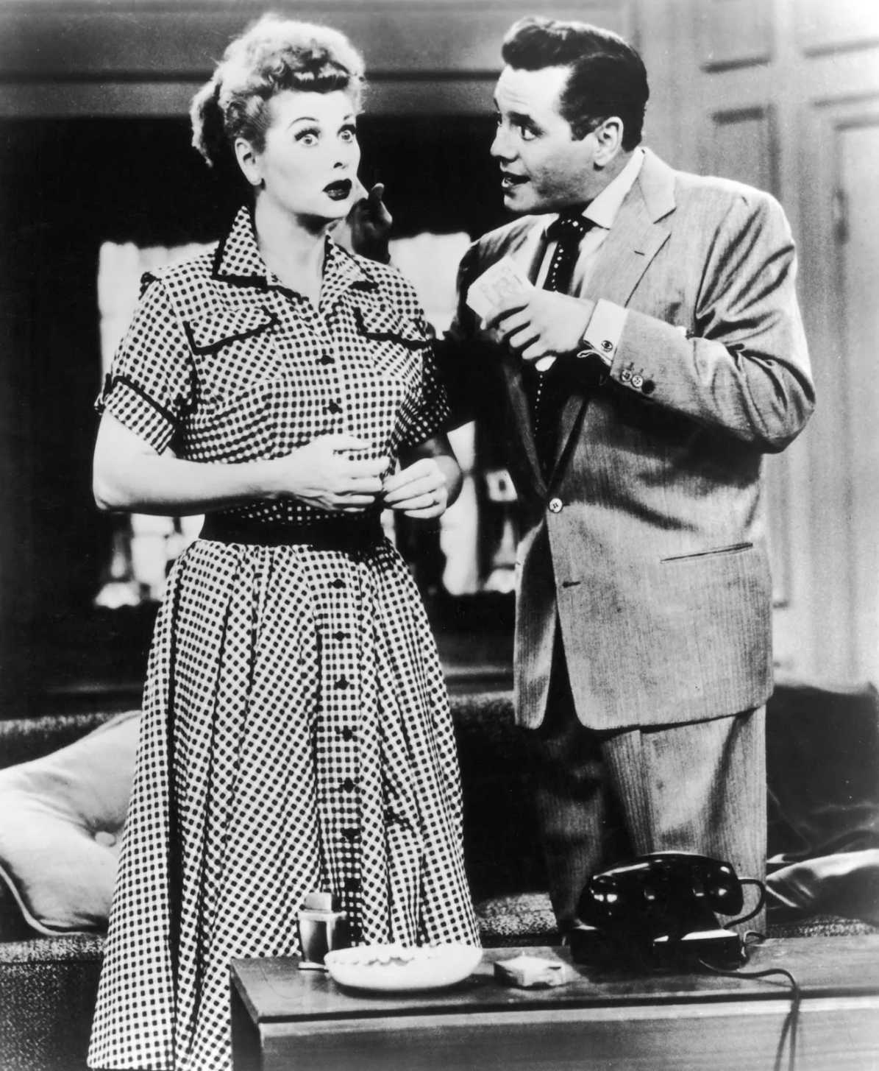
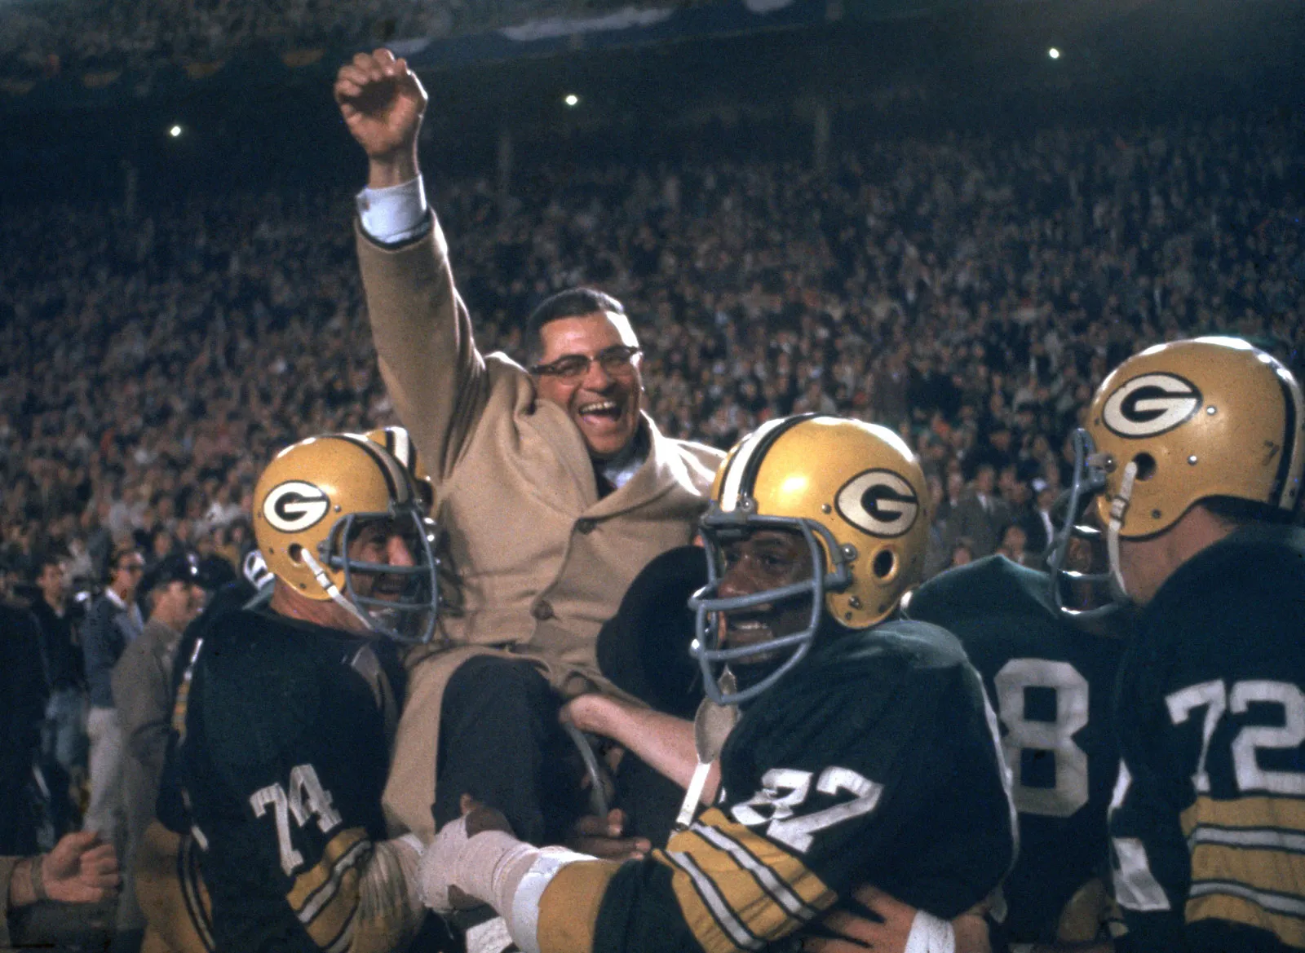
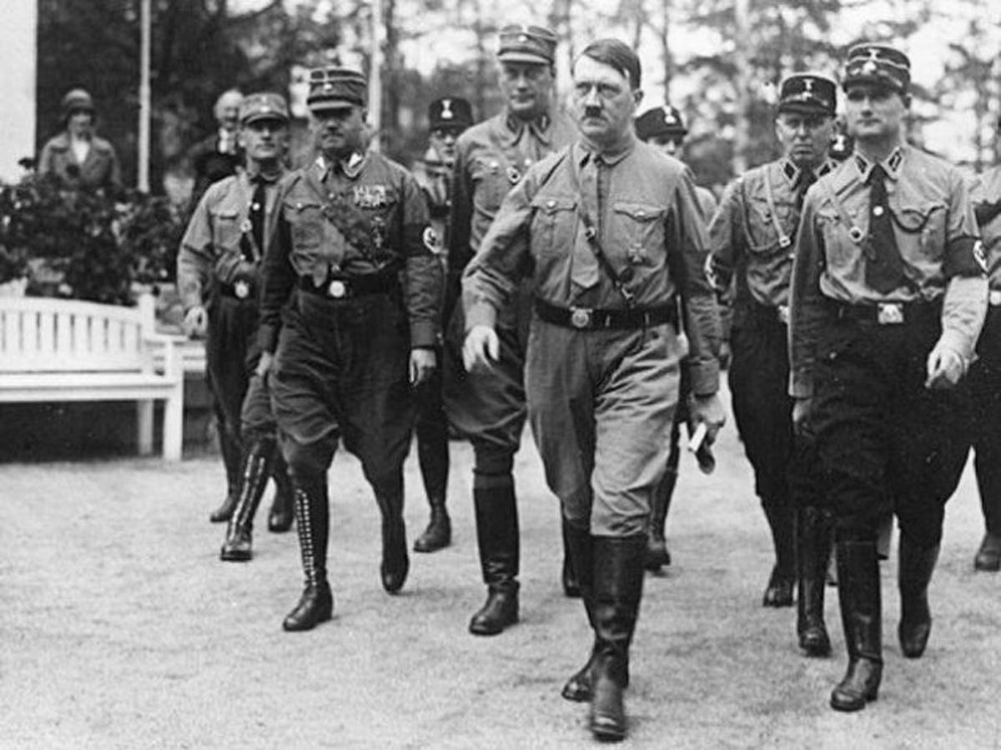
In 1943…
Notes:
In 1943, Hitler was still on the march. D-Day wouldn’t happen until the following year.
In 1943, mass produced television set wouldn’t even go on sale for another three years. I Love Lucy wouldn’t go on the air for another 8 years, in 1951.
In 1943, Vince Lombardi was still an assistant coach—for a high school basketball team. He wouldn’t become a head coach in the NFL for another 16 years.
Several rules refer to “telephone conferences.” A bunch of rules refer to fax (or facsimile). People in here that have never sent a fax?

Slide 5
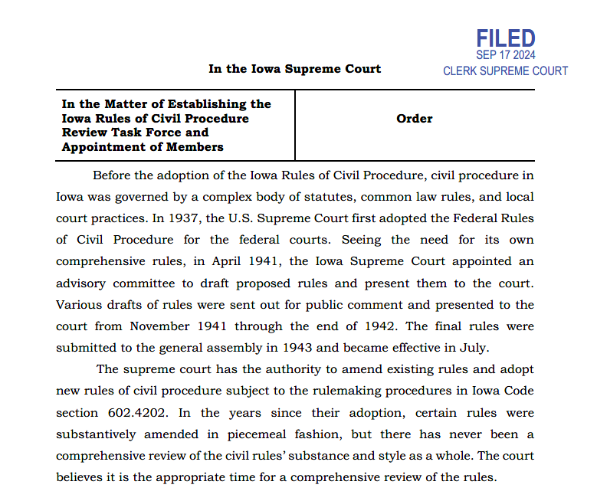

Slide 6
Members
- Hon. Matthew McDermott (chair), Justice, Iowa Supreme Court, Des Moines
- Hon. Sharon Greer (co-chair), Judge, Iowa Court of Appeals, Marshalltown
- Hon. Gina Badding (co-chair), Judge, Iowa Court of Appeals, Carroll
- Hon. David Odekirk, Judge, First Judicial District, Waterloo
- Hon. Bethany Currie, Judge, Second Judicial District, Marshalltown
- Hon. Dick Davidson, Judge, Fourth Judicial District, Clarinda
- Hon. Anuradha Vaitheswaran, ret., Iowa Court of Appeals, Des Moines
- Anne Sheeley, Clerk of Court, Fifth Judicial District, Des Moines
- Mandy Schilb, Clerk of Court, Eighth Judicial District, Batavia
- Anthony Gaughan, Professor, Drake Law School, Des Moines
- Jason Rantanen, Professor, University of Iowa College of Law, Iowa City
- Kim Baer, Private Practice Attorney, Des Moines
- Tim Bottaro, Private Practice Attorney, Sioux City
- Steve Drahozal, Assistant State Public Defender, Dubuque
- Marc Elcock, Private Practice Attorney, Osceola
- Katie Foley, Private Practice Attorney, Des Moines
- Carin Forbes, Assistant Attorney General, Des Moines
- Katie Graham, Private Practice Attorney, Des Moines
- John Gray, Private Practice Attorney, Sioux City
- Susan Hess, Private Practice Attorney, Dubuque
- Daniel Johnston, Assistant Attorney General, Ames
- Todd Lantz, Private Practice Attorney, Des Moines
- Rob Livingston, Private Practice Attorney, Council Bluffs
- Christine Luzzie, Litigation Director Emeritus, Iowa Legal Aid, Iowa City
- Kellie Paschke, Private Practice Attorney, West Des Moines
- Matt Preston, Private Practice Attorney, Cedar Rapids
- Tim Semelroth, Private Practice Attorney, Cedar Rapids
- Martha Shaff, Private Practice Attorney, Davenport
- Anjie Shutts, Private Practice Attorney, Des Moines
- Eashaan Vajpeyi, Private Practice Attorney, Waterloo
- Janece Valentine, Private Practice Attorney, Fort Dodge

Slide 7
Mission
To conduct a comprehensive review of the Iowa Rules of Civil Procedure to ensure that the rules as revised
  promote greater procedural efficiency and fairness
  are easier to read and understand
  reflect judicial interpretations and current practice
  incorporate modern technologies
  remain substantively neutral

Slide 8
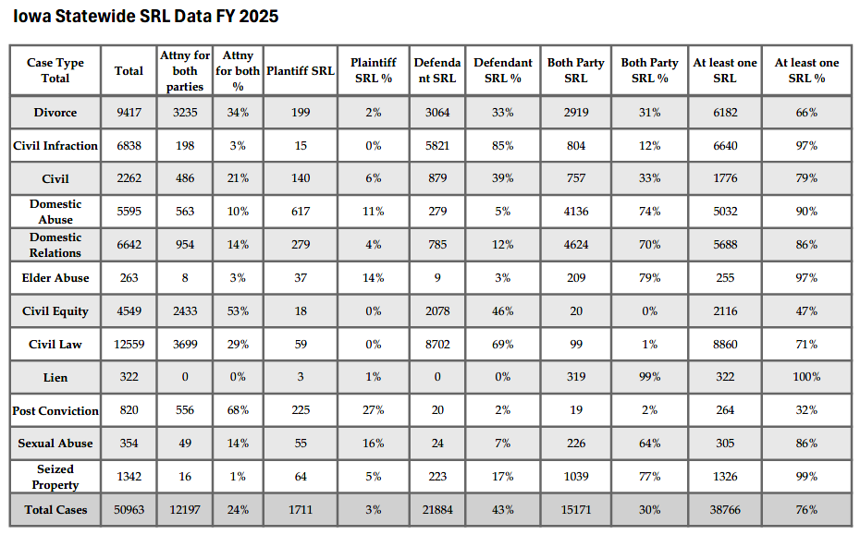
The “target audience” question
Notes:
Who is the audience? Writing for a lay audience would be ideal. Pro se representation is more prevalent than most lawyers conceive—76% of all cases (non-small-claims) have at least one pro se party.
But writing rules for a lay audience probably too difficult. Would add a layer of explanation and detail that would expand many rules beyond our mission.
More realistic, but still to aim for simplicity, might be better to consider the audience a first-year law student giving her first read to the rules as part of a class. Clerk of court? Someone with experience in legal matters. Main audience is still the legal profession.

Slide 9

Rule 1.206: Injury or death of a minor.
A parent, or the parents, may sue for the expense and actual loss of services, companionship and society resulting from injury to or death of a minor child.
But Iowa Code § 613.15A already says this—almost verbatim:
Do we really need to restate it in our rules of civil procedure?
Notes:
Last Amended: 1973 This seems more like creating a cause of action than a civil procedure rule.

Slide 10
Lincoln Savings Bank v. Emmert,
986 N.W.2d 376 (Iowa 2023)
1.972(3) Notice.
To the party.
  A copy of the notice of intent to file written application for default shall be sent by ordinary mail to the last known address of the party claimed to be in default. No other notice to a party claimed to be in default is required.
b. Represented party.
  When a party claimed to be in default is known by the party requesting the entry of default to be represented by an attorney, . . . a copy of notice of intent to file written application for default shall be sent by ordinary mail to the attorney for the party claimed to be in default.

Slide 11
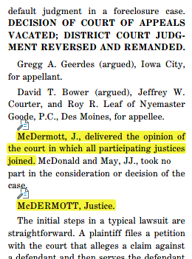
When there’s a lawyer, is notice required only to the lawyer, or to the defendant also?
Court held that the rule should be read to require notice to both the lawyer and defendant.
In other words, we read an “and” between the two subsections
Notes:
Discussed a drafting technique (and thus an interpretive reading) called “asyndeton.” When a drafter does not include a conjunction, the text “is generally considered to convey the same meaning . . . as though and were inserted between the items.”
Court also discussed how the headings for the rule suggested such a reading, and the form provided in the rules associated with the rule also supported a reading requiring both.
Pennsylvania has a similar rule, and their rule directly states the “and.” Rather than require parties to search one of our cases to see how the rule should be interpreted, makes sense to more clearly state the requirement in the rule.

Slide 12
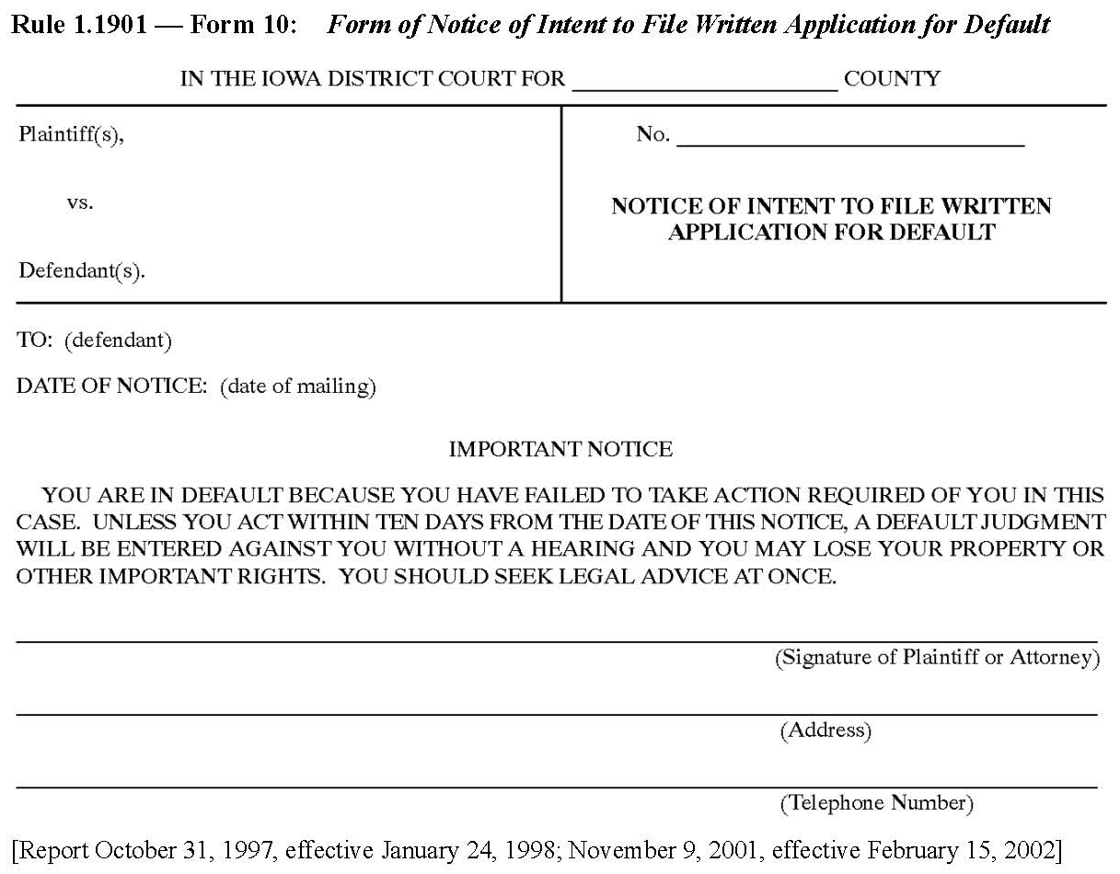
Conforming the Forms
Notes:
We will need to review the forms associated the various rules to ensure they mesh with any changes that we make.

Slide 13
Presumption of no change unless:
The rule’s language could be improved for readability and consistency
Case law has interpreted or clarified the meaning of the rule such that potential vagueness can be eliminated
The rule itself is obsolete or unnecessary
A revised rule would promote greater procedural efficiency and fairness

Slide 14

Chesterton’s Fence
Notes:
In its most concise version, the moral of Chesterton’s Fence is “Do not remove a fence until you know why it was put up in the first place.”
Fences don’t appear by accident. They are built by people who planned them and had a reason to believe they would benefit someone. Before we dismantle a fence, we have to understand the reason behind its existence.
It may serve a purpose that isn’t immediately obvious. We might ultimately decide to do away with a rule or part of a rule, but we need to understand that rationale for the rule before we start deleting.

Slide 15
Among other issues…
R. 1.413 (sanctions)
  Separate motion? Safe harbor?
R. 1.981 (summary judgment)
  60 days / 90 / 120 days before trial?
  Responding to undisputed facts?
Trial Scheduling & Discovery Plan
  Deadline to add new parties? Discovery? SJ?
R. 1.443 (+3 days after service by mail)
  Join the federal courts and discard?
Notes:
Some judges basing MSJ deadlines on the size of the appendix (>100 pages = 90 days before trial, <100 = 60 days)
Iowa Rule of Civil Procedure 1.443(2) adds three days to a prescribed period when served by mail, email, or fax. Iowa Court Rule 16.317 does not change any such rule when a party is served electronically.

Slide 16

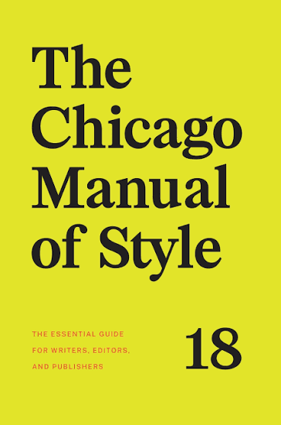
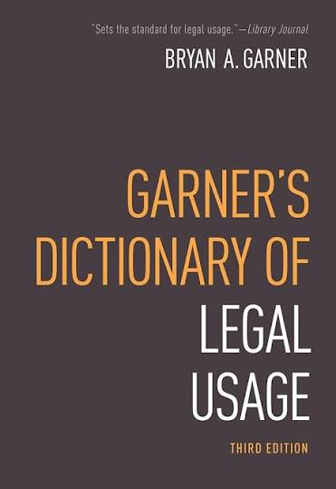
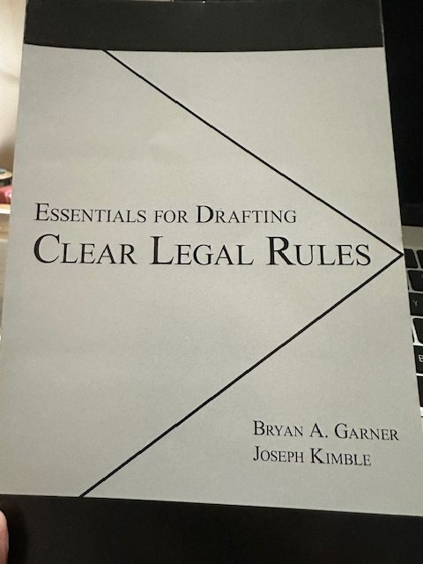
Style Guides
Essentials for Drafting Clear Legal Rules (2024) by Bryan A. Garner & Joseph Kimble
Chicago Manual of Style (18th ed. 2024)
Garner’s Dictionary of Legal Usage (3d ed. 2011)
Garner’s Modern English Usage (5th ed. 2022)

Slide 17
Preferences
No changes to the rule numbers, with ordering done at the subdivision level—(a), (b), (c)—and lower
No changes to well-worn phrases in Iowa law (e.g., keep “no genuine issue as to any material fact” over the simpler “no genuine issue of material fact”)

Slide 18
Elegant Variation
Jon pulled the dust sheet off the convertible. The convertible gleamed in the dim light of the garage after months in storage. He slid into the driver's seat of the convertible and turned the key. The convertible roared to life with a growl. He couldn’t wait to take the convertible out onto the open road.
Jon pulled the dust sheet off the convertible. The vintage roadster gleamed in the dim light of the garage after months in storage. He slid into the driver's seat of the two-seater and turned the key. The classic machine roared to life with a growl. He couldn't wait to take his cherished summer ride out onto the open road.

Slide 19
Consistency
“for good cause shown”
  Rs. 1.281(4)(b), (f), (g)(3)(3); 1.435; 1.504; 1.509(1)(e); 1.515; 1.710; 1.1007; etc.
“for good cause”
  Rs. 1.441(6); 1.500(3)(b); 1.509(1)(c); 1.512(2)(b)(3); 1.1701(3)(b)(2)
“for just cause”
  R. 1.702
“for any cause not growing out of the fault or negligence of the movant”
  R. 1.911(1)
“upon a showing . . . of . . . reasonable cause”
  R. 1.944(6)
“for cause shown”
  Rs. 1.443(1); 1.701(3)
Notes:
Elegant variation, while important in most writing, is to be avoided in crafting rules.
We generally say when construing a statute that a change in language indicates a change in meaning.
Does it need to be “shown”? Maybe it needs to be shown, but does it need to be “good”?
Inconsistencies often arise through amendments

Slide 20
Consistency
“costs and expenses of the litigation”
  R. 1.276(1)
“costs and litigation expenses”
  R. 1.276(2)
“costs . . . including a reasonable attorney fee”
  R. 1.413(2)
“costs in a reasonable amount fixed by the court for expenses incurred by the plaintiff and plaintiff’s attorney”
  R. 1.801(5)
“reasonable expenses, including attorney fees”
  Rs. 1.503(6)(c); 1.517(7)
“reasonable expenses and attorney fees”
  R. 1.708(2)(a)
“reasonable expenses incurred, . . . including a reasonable attorney fee”
  R. 1.413(1)
“costs, which may include reasonable compensation for defendant’s trouble and expense, including attorney’s fees”
  R. 1.808(1)
Notes:
Are costs different than expenses?
What about costs for expenses incurred?
Are attorney’s fees a subset of expenses?
Do reasonable expenses imply reasonable attorney’s fees?

Slide 21
Rule 1.201 Real party in interest.
Rule 17. Plaintiff and Defendant; Capacity; Public Officers.
Every action must be prosecuted in the name of the real party in interest. But an executor, administrator, conservator, guardian, trustee of an express trust, or a party with whom or in whose name a contract is made for another’s benefit, or a party specially authorized by statute may sue in that person’s own name without joining the party for whose benefit the action is prosecuted. No action shall be dismissed on the ground that it is not prosecuted in the name of the real party in interest until a reasonable time has been allowed after objection for ratification of commencement of the action by, or joinder or substitution of, the real party in interest; and such ratification, joinder, or substitution shall have the same effect as if the action had been commenced in the name of the real party in interest.
(a) Real Party in Interest.
(1) Designation in General. An action must be prosecuted in the name of the real party in interest. The following may sue in their own names without joining the person for whose benefit the action is brought:
(A) an executor;
(B) an administrator;
(C) a guardian;
(D) a bailee;
(E) a trustee of an express trust;
(F) a party with whom or in whose name a contract has been made for another’s benefit; and
(G) a party authorized by statute.
Notes:
We have compared the federal rules to the Iowa rules. In part, to see where the federal rules have a rule that we don’t have—and that we might want—and where the feds have no rule that we might consider deleting.
Example of an Iowa rule and a corresponding federal rule where you can see the effects of restyling. Federal rules have gone through significant restyling. More headings, more subparts, more lists. Easier to read and parse.

Slide 22
Federal restyling example
Old F.R. Evid. 104(a)
Preliminary questions concerning the qualification of a person to be a witness, the existence of a privilege, or the admissibility of evidence shall be determined by the court, subject to the provisions of subdivision (b).
Current rule
The court must decide any preliminary question about whether a witness is qualified, a privilege exists, or evidence is admissible.
Notes:
Shorter sentences. Avoiding long gaps between the subject and the verb.

Slide 23
Old Fed. R. Civ. P. 17(b)
Current rule
(b) Capacity to Sue or Be Sued. The capacity of an individual, other than one acting in a representative capacity, to sue or be sued shall be determined by the law of the individual’s domicile. The capacity of a corporation to sue or be sued shall be determined by the law under which it was organized. In all other cases capacity to sue or be sued shall be determined by the law of the state in which the district court is held, except . . . .
(b) Capacity to Sue or Be Sued. Capacity to sue or be sued is determined as follows:
(1) for an individual who is not acting in a representative capacity, by the law of the individual’s domicile;
(2) for a corporation, by the law under which it was organized; and
(3) for all other parties, by the law of the state where the court is located, except . . ..

Slide 24
Eliminate wordiness
Rule 1.413(1): “in violation of this rule” / “violates this rule”
Rule 1.443(1): “before the expiration of the period” / “before the period expires”
Rule 1.1702(1)(e)(1): “give testimony at a deposition” / “testify at a deposition”
Rule 1.926(1): “at the completion of the jury’s deliberations” / “when the jury completes its deliberations”
Rule 1.1010(3): “in the event of an appeal” / “after an appeal”

Slide 25
Conducting our work
Assignment to one of three workgroups, each having 9–10 members
  Drafting subgroup
Workgroups prepare proposed modified rules and forms
Full task force will discuss all proposed modified rules and forms
Notes:
Each member will serve on only one workgroup
Meetings will typically be by Zoom
Learned from experience that drafting rules often works better in person

Slide 26
Three workgroups
Pleadings, parties, and motions
  (Rules 1.101–1.458, 1.801–1.808 (venue))
Discovery, disclosures, and depositions
  (Rules 1.500–1.728, 1.1701–1.1702 (subpoenas))
Trial, judgment, and special proceedings
  (Rules 1.901–1.1603, 1.1801–1.1807 (rules of a general nature))
Notes:
Each TF member ranked preferences for workgroup assignments. Worked out that almost everyone got first preference.
Greer, Badding, McDermott chairing the workgroups.

Slide 27
Beginning the work
Begin with broad subjects
  Cases interpreting rules
  Places where IRCP and FRCP are different
  Subgroup assignments addressing deficiencies in current rules
Rule-by-rule review once the broad subject research is done
OneDrive repository for documents, drafts, style guides, contact info, etc.
Notes:
The more you can specify work for smaller subgroups, the better.

Slide 28
Timeline
Monthly workgroup meetings via Zoom
  Smaller subgroups may meet between as needed
Full task force review of recommendations
Proposal to the supreme court
  Court may accept or reject in whole or in part
Public comments (and responses)
Anticipate several years to completion

Slide 29
The Final Steps:
Iowa Code § 602.4202
Court submits to legislative council and to chairs and ranking members of the House and Senate committees on the judiciary
  Legislative Services Agency may make recommendations on style and format
Rule takes effect 60 days after submission to legislative council unless legislative council delays the effective date
The legislature may enact a bill changing any rule or form submitted
Notes:
Please do not share drafts with others, with list-serves, etc., as the drafts are prepared. We will have an opportunity to “street” all these proposals.

Slide 30

The End

