Slide 1

You Gotta Be Kidding me! That injection cost what?
Combating Outrageous Medical Expenses
Presented by
Spencer Vasey Dirth

Slide 2
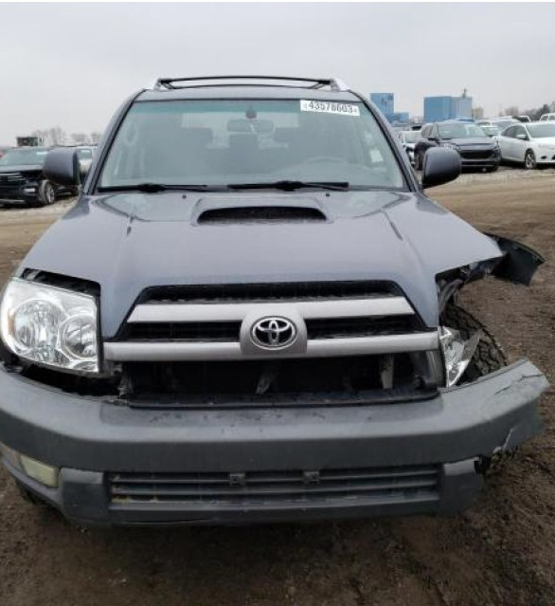
A hypothetical
The Accident
Residential area – (25 mph speed limit)
Failure to yield on left turn
Plaintiff’s vehicle damage appx. $9,000
The Treatment
ER on DOL (2 X-Rays & CT Scan)
7 months of chiro (26 visits)
3 Ortho Visits
3 MRIs
1 Pain Medicine Visit
Bilateral Cervical & Lumbar ESIs
Bilateral Lumbar Rhizotomy
All treatment complete within 15 months

Slide 3

A Hypothetical
The Treatment
The Charge
The Payment
Ambulance
ER & Imaging
26 Chiropractic Visits
3 MRIs
3 Ortho Visits
1 Pain Medicine Visit
Bilateral Cervical & Lumbar Epidural Steroid Injections
Bilateral Lumbar Rhizotomy
TOTAL
$1,702.67
$ 413.28 – Paid By Insurance
$5,624.38
$ 480.67 – Paid By Insurance
$1,040.00
$ 1,040.00 – Paid By Insurance
$ 5,250.00
$5,250.00 – DUE
$ 2,961.76
$2,961.76 – DUE
$ 875.00
$875.00 – DUE
$ 78,847.27
$78,847.27 – DUE
$ 130,795.57
$130,795.57 – DUE
$ 227,096.66
$ 220,663.56

Slide 4

So…what do I do?

Slide 5

Pexa v. Auto Owners
686 N.W.2d 150 (Iowa 2004)
Facts:
  Car accident
  $41,000 charged; $16,000 paid
  Defendant agreed to stipulate that expert would testify charges were fair & reasonable
Holding:
  The reasonable & necessary cost of care is (a) the amount to satisfy the bills; or (b) the amount an expert testifies is reasonable & necessary
Analysis:
  Claimant can recover reasonable & necessary costs of medical care
  Amount paid to satisfy is reasonable
  Amount charged is irrelevant absent expert testimony that charges are reasonable – then claimant can recover this sum
  Plaintiff should have been able to argue for recovery of full amount charged

Slide 6

The 2020 legislation
668.14A Recoverable damages for medical expenses.
In an action brought to recover damages for personal injury, the damages that may be recovered by a claimant for the reasonable and necessary cost or value of medical care rendered shall not exceed the sum of the amounts actually paid by or on behalf of the injured person to the health care providers who rendered treatment and any amounts actually necessary to satisfy the medical care charges that have been incurred but not yet satisfied.
622.4 Medical expenses.
Evidence offered to prove past medical expenses shall be limited to evidence of the amounts actually paid to satisfy the bills that have been satisfied, regardless of the source of payment, and evidence of the amounts actually necessary to satisfy the bills that have been incurred but not yet satisfied. Evidence of the amounts actually necessary to satisfy the bills that have been incurred shall not exceed the amount by which the bills could be satisfied by the claimant’s health insurance, regardless of whether such health insurance is used or will be used to satisfy the bills. This section does not impose upon any party an affirmative duty to seek a reduction in billed charges to which the party is not contractually entitled.

Slide 7
In other words…
Recoverable damages are amounts paid (if satisfied) or amounts actually necessary to satisfy outstanding charges (622.14A)
Actually necessary to satisfy means amount health insurance has contracted to pay that charge (622.4)

Slide 8
How do you prove it?
Billing Expert
Published Discounts
Financial Assistance Policies / Self-Pay Discounts
Discovery
Objections

Slide 9
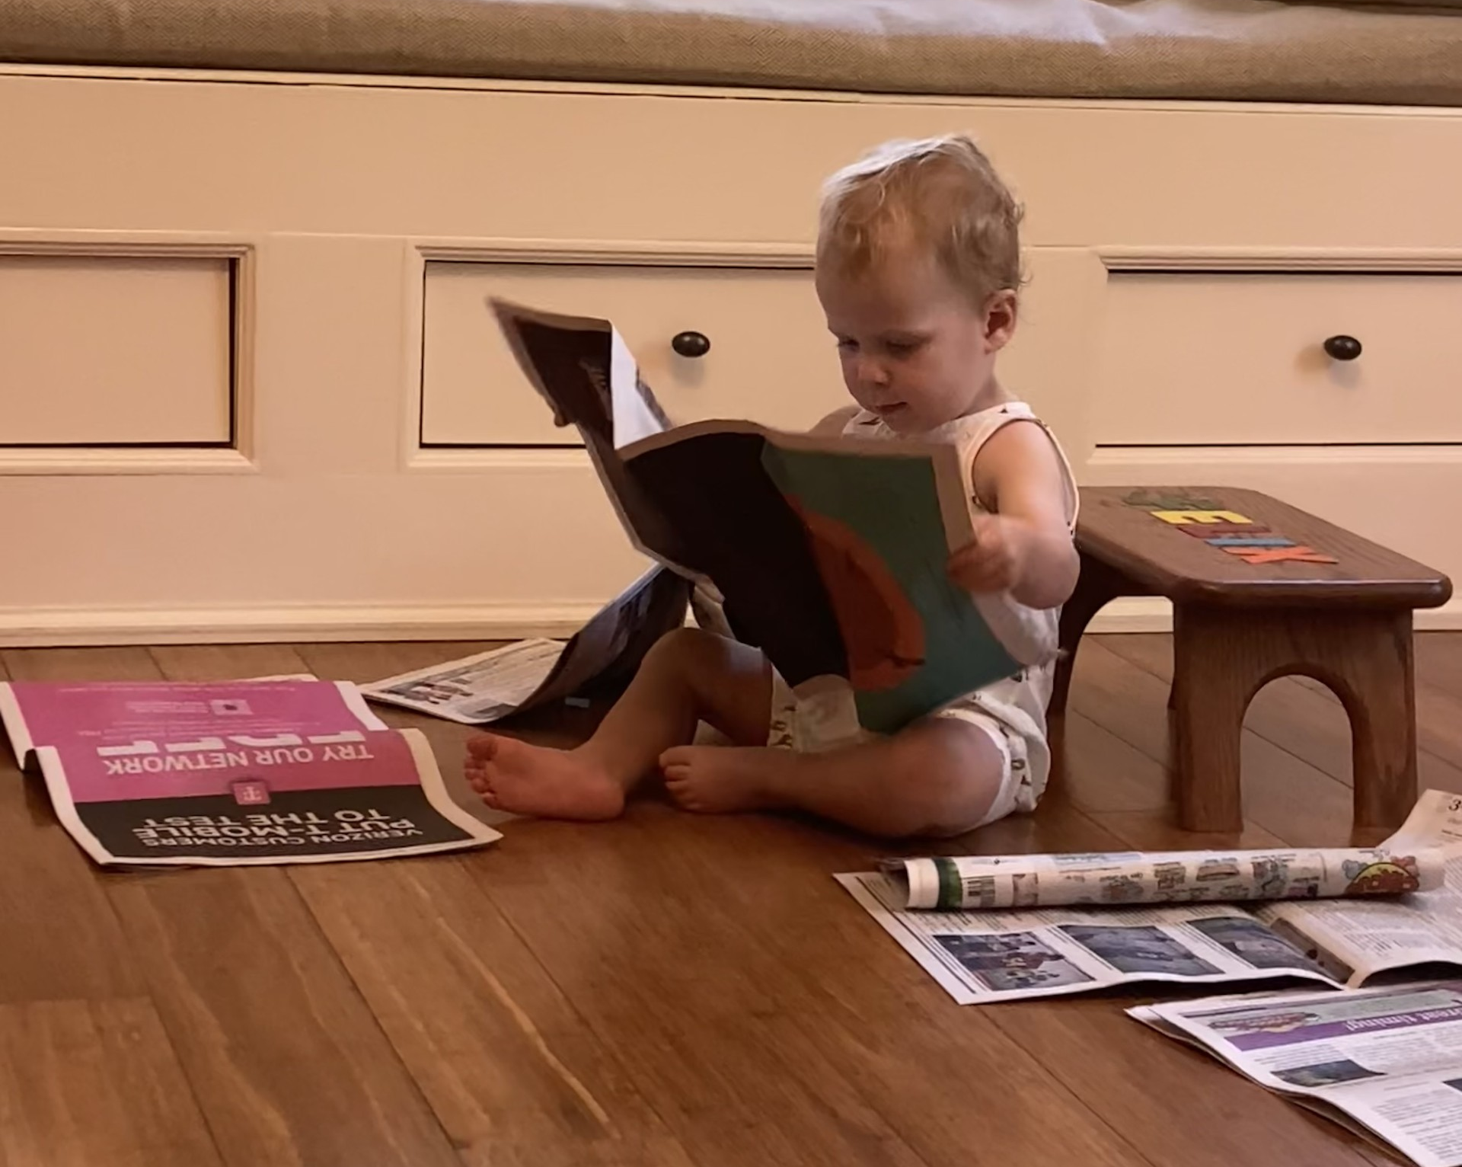
Billing expert
Reviews bills & plaintiff’s health insurance information
Testimony re. contracted adjustments (if available) or self-pay discounts
Expensive

Slide 10

Published Discounts
42 USCA 300gg-11 – Preventing Surprise Medical Bills (No Suprises Act)
  Passed in 2022
  Requires providers/insurers to publish or provide information on:
    Negotiated rate for in-network services
    Good faith estimate of amount plan will pay for out-of-network services
    Good faith estimate of amount insured will pay for out-of-network services

Slide 11
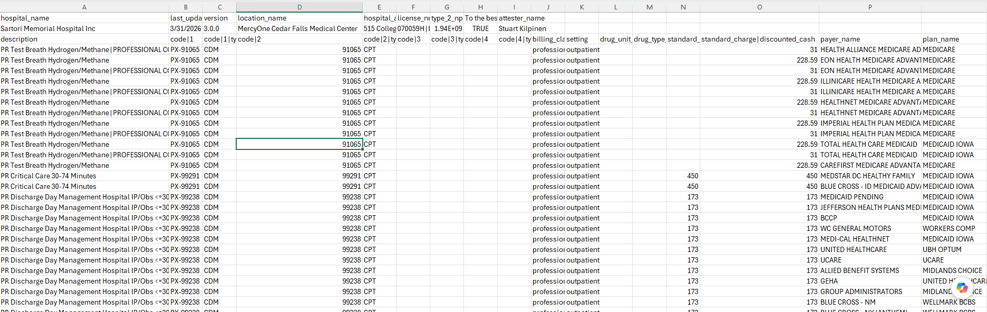
Procedure | Procedure Code | Insurer | Standard Charge | Footnote
HC ED Type a Level 5 Sane_Safe | 99285 | BLUE CROSS - CO (ANTHEM) | $2,244.00 | Estimated Allowed Amount: $608.43

Slide 12

Financial assistance policies/Self-pay discounts
Providers typically provide discounts for uninsured patients
  Often available on website as Financial Assistance Policy
  Typically a percentage of the charge as the self-pay discount
  Sometimes require patient fall within certain income brackets
Use on cross of Plaintiff’s experts
BUT BEWARE OF IOWA CODE 622.4
  “This section does not impose upon any party an affirmative duty to seek a reduction in billed charges to which the party is not contractually entitled.”

Slide 13

discovery
Written Discovery
  Health insurance card
  All assignments or agreements with provider about payment of unpaid bills
Subpoena to health insurer or provider for adjusted rates
Subpoena or record request to provider including all assignments and communications
Deposition of Plaintiff
  Referrals
  Pay arrangements

Slide 14

Object, object, object!
Do NOT stipulate to medical bills
Hearsay & Foundation Objections
  Rule 5.801 (Hearsay)
    Business Record Exception - Rule 5.803(6)
      Requires testimony of custodian or another qualified witness
I STRONGLY
OBJECT!

Slide 15


Questions?
(and applause)

