Slide 1
Defense of Public Entities & Updates In Municipal Litigation
Jason C. Palmer
Ryan P. Tunink
Georgia R. Rice

Slide 2
1000 Friends of Iowa v. Polk Cnty. Bd. of Supervisors, 19 N.W.3d 290 (Iowa 2025)
Dispute over rezoning parcel of land.
Defendant moved to dismiss based on pleading standards imposed by Iowa Code section 670.4A(3).
Heightened pleading standards only apply to claims for money damages.
Extensive analysis on the Plaintiffs’ standing to bring the suit.

Slide 3
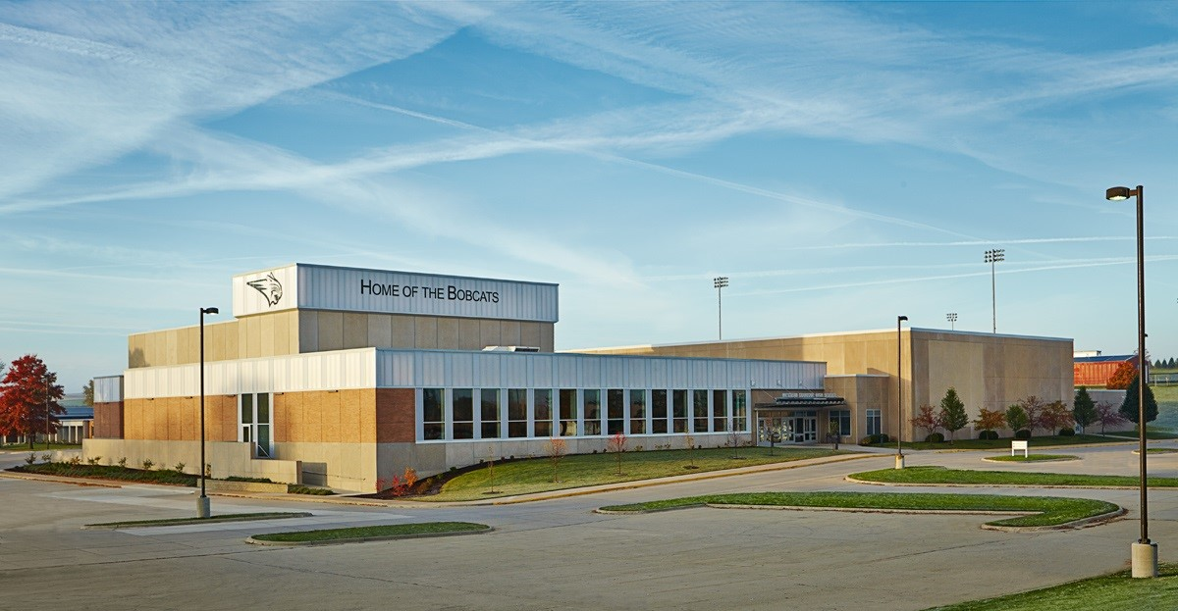
Doe v. W. Dubuque Cmty. Sch. Dist., 20 N.W.3d 798 (Iowa 2025)
Plaintiff asserted claims of negligence and breach of fiduciary duty over alleged assault of a student perpetrated by a peer.
Concludes qualified immunity under Iowa Code section 670.4A(1) did not apply.
Only apply to claimed violations of statutory or constitutional rights.
Also rejected Plaintiff’s breach of fiduciary duty claim—schools are not fiduciaries.

Slide 4
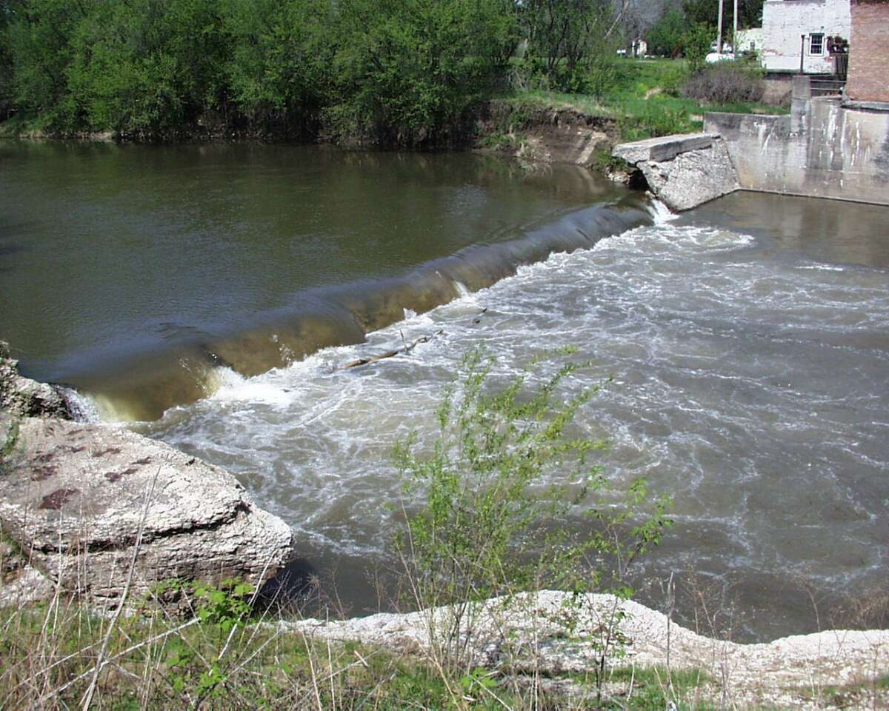
Est. of Kahn by Rowe v. City of Clermont, 22 N.W.3d 252 (Iowa 2025)
Claimed negligence and premises liability arising from death at base of a low-head dam.
Heightened pleading standards did not apply.
Also rejects application of Public Duty Doctrine.
As pled, danger was from affirmative conduct by government entities.

Slide 5
Diercks v. Scott Cnty., 17 N.W.3d 364 (Iowa 2025)
Confidentiality of applications to fill vacant board of supervisors’ seats.
County claims confidential under Iowa Code section 22.7(18)—a reasonable person would be discouraged from making document if it was made public.
Overturns summary judgment that had been granted to Scott County: Public seat, actual applicants were not concerned.
Three Justice dissent.
Precedent had already applied 22.7(18) in employment application contexts, nothing different here.

Slide 6
Harrison v. Mickey, 18 N.W.3d 477 (Iowa 2025)
Open Records request following George Floyd Protests
Use of force reports were not personal information in confidential personnel records under Iowa Code section 22.7(11)(a)
Could result in discipline to officers, but rarely do. Not actually performance records. Are not kept in officer’s personnel files.
Also rejects protections under Iowa Code section 80F.1(20)
Section does not protect reports that were not prepared in response to a complaint.

Slide 7
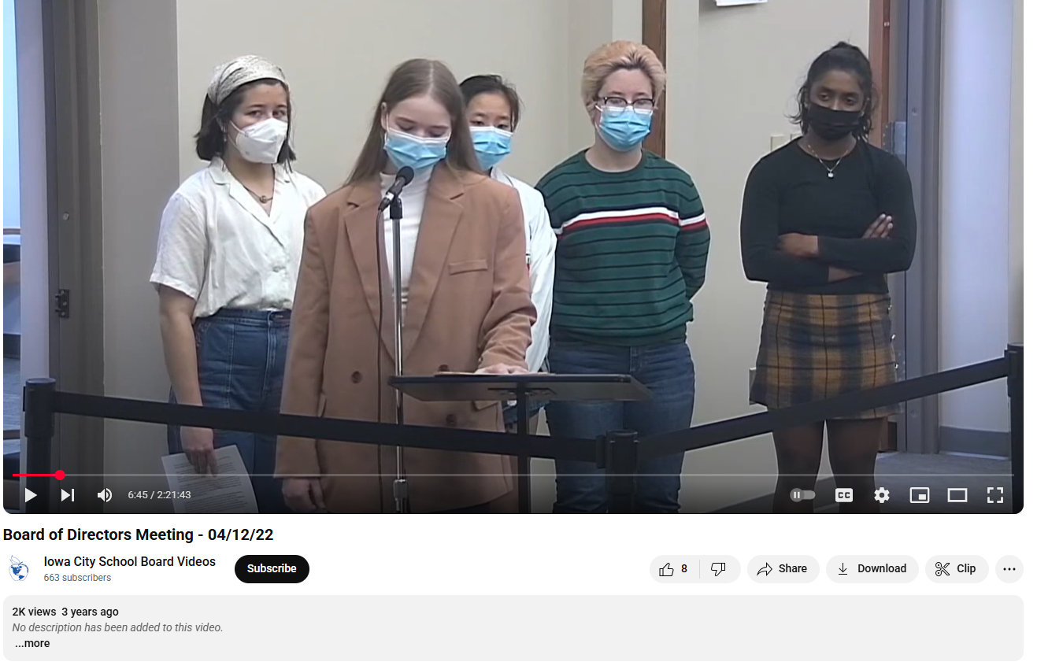
Villarini v. Iowa City Cmty. Sch. Dist., 21 N.W.3d 129 (Iowa 2025)
Students alleged tennis coach engaged in various misconduct. Investigation concludes claims were unfounded.
Students speak at ICCSD Board of Directors meeting, video of which is published on the Board’s Youtube.
Court officially adopts the Fair Report Privilege.
Intent is irrelevant; focus is inaccuracy of report.

Slide 8
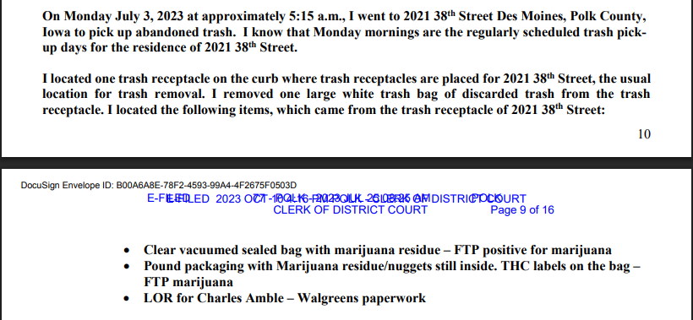
State v. Amble, 22 N.W.3d 265 (Iowa 2025)
State v. Wright, 961 N.W.2d 396 (Iowa 2021) provided expectation of privacy in trash left for collection in some circumstances.
Legislature responded with Iowa Code section 808.16.
Court finds Section 808.16(3) is facially constitutional, dodges the remaining provisions on constitutional avoidance grounds.
Technically does not overturn Wright.

Slide 9
Singer v. City of Orange City, 15 N.W.3d 70 (Iowa 2024)
City ordinance required periodic inspections of rental properties.
If entry was denied to inspector, inspector could obtain administrative search warrant.
Gestures at Camara v. Municipal Court, 387 U.S. 523 (1967), which allows lesser standard for administrative warrants than criminal ones.
Rejects facial challenge under article I, section 8.
Did not rule on whether an as-applied challenge would fail.

Slide 10
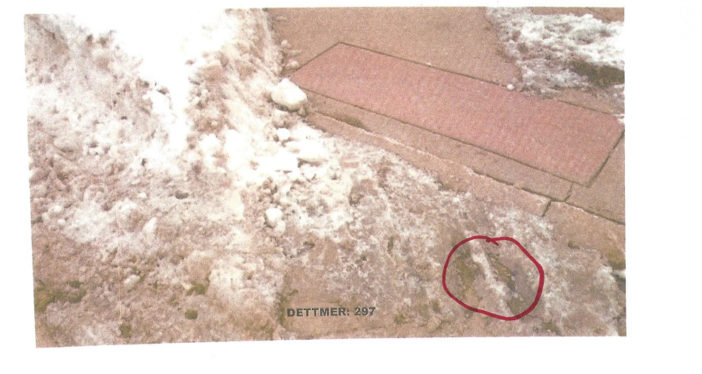
Snow Removal
Dettmer v. City of Coralville, No. 24-0248, 2025 WL 706560 (Iowa Ct. App. Mar. 5 2025)
  Applies Iowa Code section 668.10(1)(b)
  Concludes fall occurred on street, not sidewalk.
Rodriguez-Flores v. City of Des Moines, No. 24-0365, 2025 WL 1066430, (Iowa Ct. App. 2025)
  Applies Iowa Code section 668.10(1)(b)
  Section 668.10(1)(b) does not require city policy to enforce a particular standard of snow removal or time frame. Just need to follow policy.

Slide 11
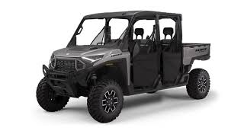
State v. Sampson, 14 N.W.3d 152 (Iowa Ct. App. 2024)
Suspect stopped for operating a UTV on city streets, violating local ordinances. Ultimately arrested for operating the UTV while intoxicated.
Argues ordinance is preempted by Iowa Code section 321I.
Court of Appeals rejects preemption argument. Cities can regulate use of UTV’s on streets pursuant o section 321I.30.

Slide 12
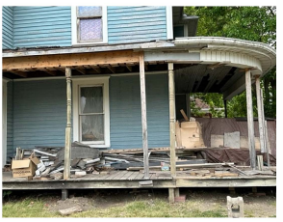
City of Donnellson v. Walljasper, No. 23-1261, 2024 WL 4039419 (Iowa Ct. App. Sept. 4, 2024)
City petitions for abandoned property under Iowa Code section 657A.10B.
Applies twelve factors to determine whether abandoned.
Affirms awarding title to City despite fact that owner had made some progress in repairing property.

Slide 13



Thank you!
Jason C. Palmer
PARTNER
jpalmer@ldmlaw.com
515-513-5003
Ryan P. Tunink
Associate
rtunink@ldmlaw.com
515-513-5003
Georgia R. Rice
Associate
grice@ldmlaw.com
515-513-5003

