Slide 1

Case Law Update:
Contracts and Commercial Law
2025 Iowa Defense Counsel Association
61st Annual Meeting and Seminar
Jaquilyn Waddell Boie
Heidman Law

Slide 2
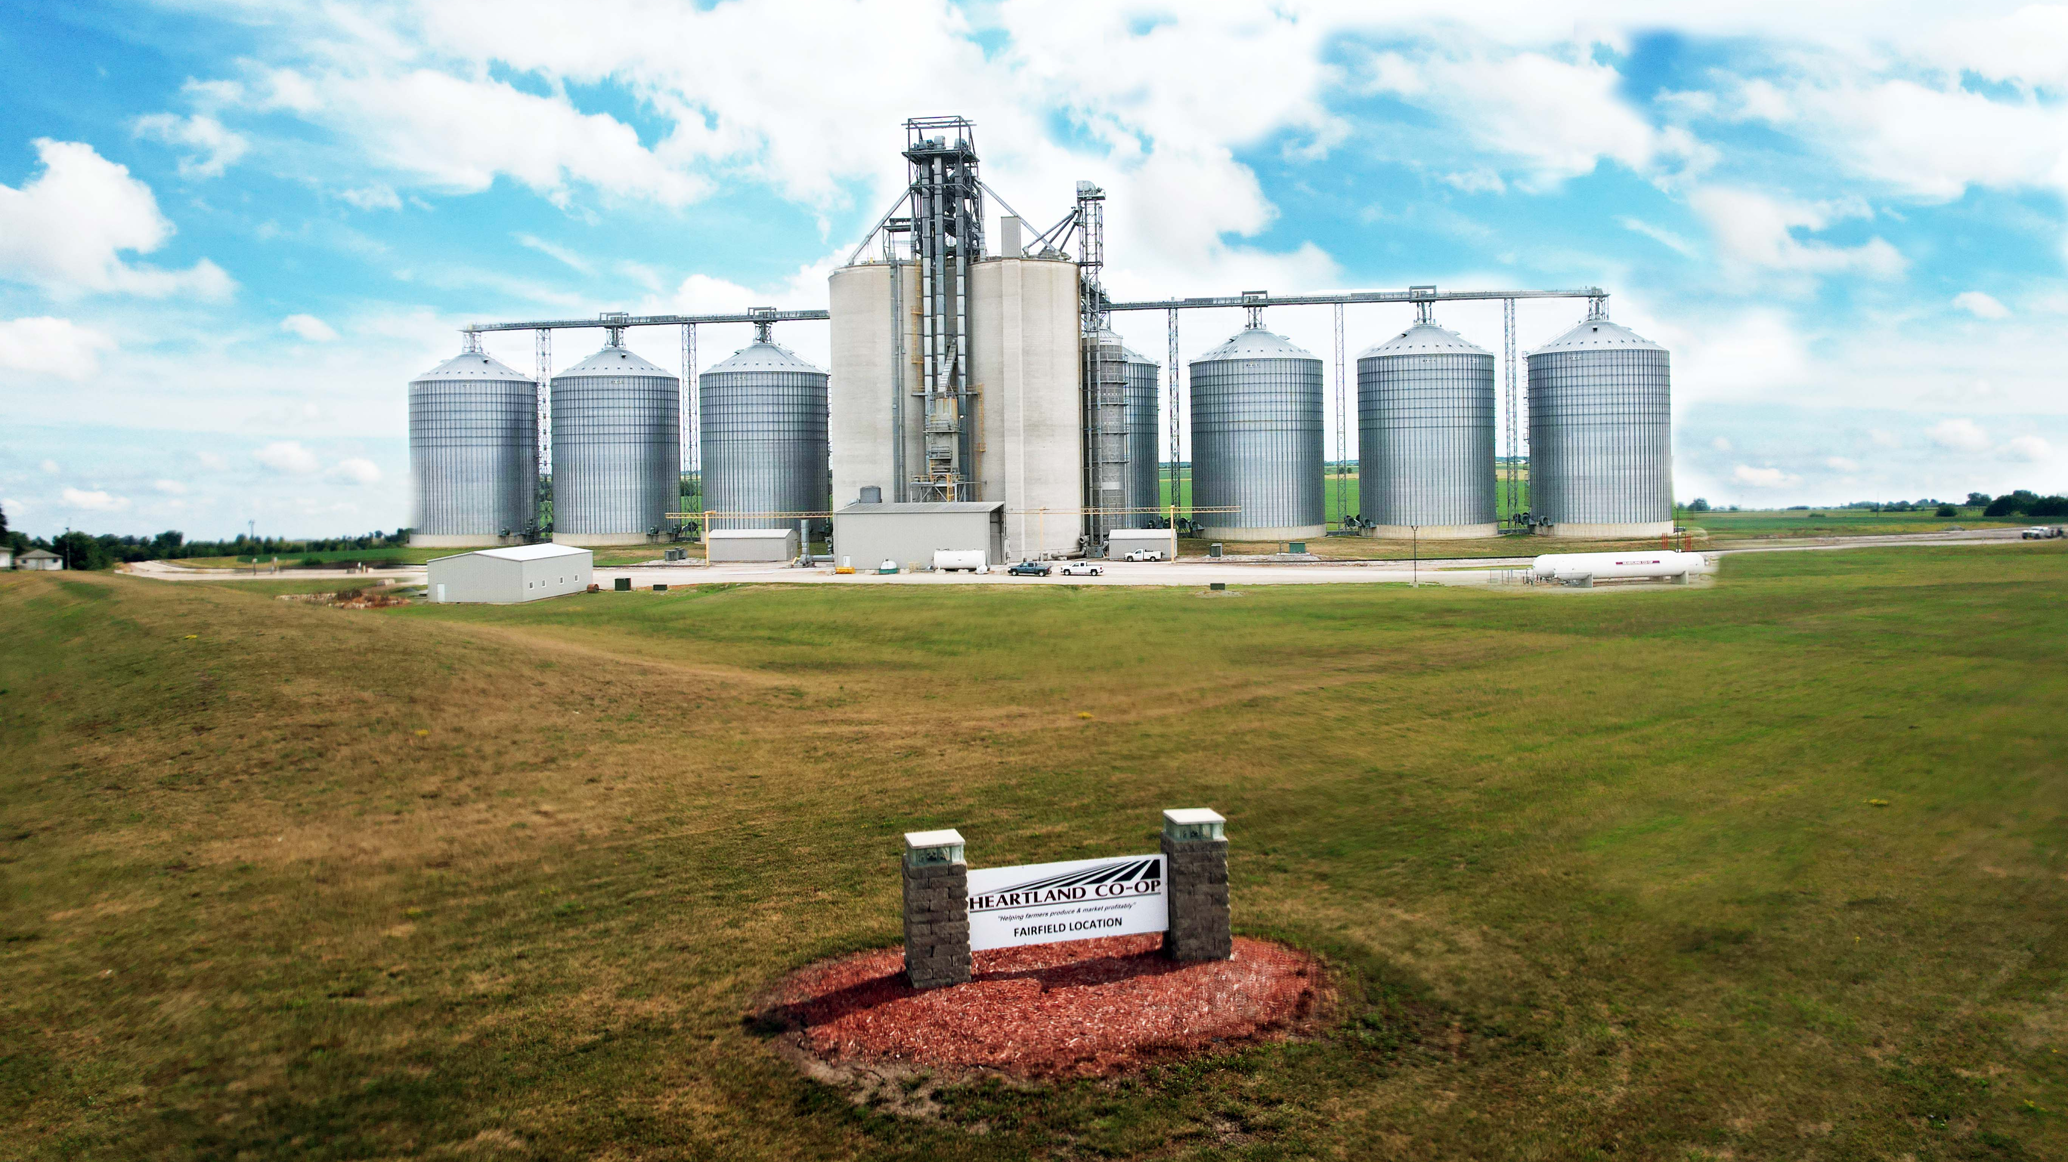
Heartland Co-op v. Nationwide Agribusiness Ins. Co.
18 N.W.3d 729 (Iowa 2025)
Heartland’s operations were significantly affected by an August 2020 derecho
Heartland claimed that the $3M limit for earnings and extra expense coverage applied to each location
Nationwide claimed the limit applied per occurrence as a blanket limit rather than a per location basis

Slide 3
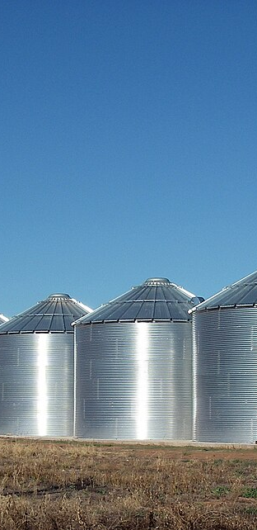
Heartland Co-op v. Nationwide Agribusiness Ins. Co.
18 N.W.3d 729 (Iowa 2025)
At issue: Interpretation of “any one loss”
District Court: derecho was a single weather event, and Heartland was one integrated business entity with many locations
  “any one loss” unambiguous – indiscriminate singular amount of financial detriment suffered at all covered locations
Court of Appeals: “any one loss” unambiguous – aggregate loss experienced by Heartland as a whole across “all covered locations”
Affirmed
  Note: Court looked to the amount of premium paid, noting that while coverage cannot be related in direct proportion to premiums paid, it goes to reasonableness of insured’s expectations
This Photo by Unknown Author is licensed under CC BY-SA

Slide 4

Waterloo Community School District v. EMC
18 N.W.3d 257 (Iowa 2025)
Roof of a near-90 year old elementary school building roof collapsed into a second-floor classroom following a heavy snowstorm
Subsequent investigations revealed load-bearing walls had deteriorated, and the entire building was declared unsafe
WCSD demanded payment under its insurance policy for restoration of load-bearing walls for the entire building

Slide 5

Waterloo Community School District v. EMC
18 N.W.3d 257 (Iowa 2025)
At issue: Whether the policy’s “ordinance and law” provision extends coverage for costs to fix areas of the building undamaged by a collapse when such restoration is required by local building codes
  Unambiguous exception for pre-existing code violations
  “[W]e will not pay any costs due to an ordinance or law that (a) You were required to comply with before the loss, even when the building was undamaged; and (b) You failed to comply with.”
WCSD was unaware of deterioration until after the roof collapsed
  Applicable building code did not grandfather owners of an older building from compliance until a calamity necessitated major renovations
  Court would not rewrite policy language to add knowledge requirement
Providing coverage for pre-existing code violations would turn the policy into a “general maintenance contract”

Slide 6

Dostart v. Columbia Insurance Group
20 N.W.3d 225 (Iowa 2025)
Dostarts sued general contractor Tyler Custom Homes for consumer fraud and obtained a $200k judgment
Columbia Ins. Group provided a CGL policy to Tyler Custom Homes but declined to indemnify the judgment under consumer fraud and exemplary award exclusions
Dostarts brought action against Columbia Ins. Group

Slide 7

Dostart v. Columbia Insurance Group
20 N.W.3d 225 (Iowa 2025)
At issue: Whether statutory consumer fraud constitutes an “occurrence” of property damage under the CGL
  Dostarts conceded exemplary damages were not covered
Mens rea distinction between common law fraud and statutory consumer fraud
  Court of Appeals: distinction critical – affirmed trial court
  Supreme Court: coverage for claims based upon poor performance would convert a CGL into a performance bond
Defective or incomplete workmanship, standing alone, is not an occurrence under a CGL policy
  Regardless of who is responsible for the defective or incomplete work, it cannot be characterized as an accident under Iowa law

Slide 8
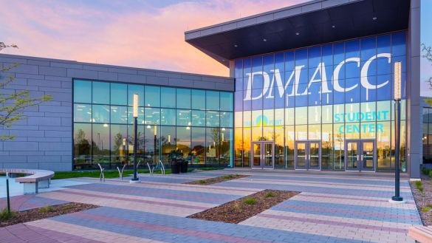
Rochon Corp. of Iowa n/k/a Graphite v. DMACC
14 N.W.3d 111 (Iowa 2024)
DMACC hired Graphite for a construction project on the DMACC Ankeny campus
Graphite submitted monthly requests for progress payments, which the architect approved. DMACC withheld 5% of each payment as retainage
January 2022: Graphite submits what was effectively its final invoice; however, all that remained was the retainage

Slide 9
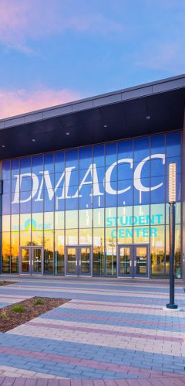
Rochon Corp. of Iowa n/k/a Graphite v. DMACC
14 N.W.3d 111 (Iowa 2024)
Graphite demanded Metro Concrete file suit seeking payment for unpaid services; Graphite and DMACC named as defendants
Graphite filed Motion to Compel DMACC to Release Retainage, seeking retainage and attorney fees
  Trial Court: Iowa Code § 573.16 does not require DMACC to release the retainage before final completion and acceptance of the project
Court of Appeals: Graphite entitled to retainage, but not attorneys fees
Supreme Court:
  Chapter 573 makes clear that the retainage cannot be released before 30 days after the completion and final acceptance
  Graphite cannot use a post-lawsuit bonding off process to obtain the retainage early, particularly given statutory periods for claims and bringing suit
  No exception applied

Slide 10

Matter of Bitcoin Depot Operating, LLC, 21 N.W.3d 157 (Iowa 2025)
Matter of Cason, 21 N.W.3d 165 (Iowa 2025)
Carlson: contacted by “Geek Squad” and told her accounts had been compromised. Directed to purchased Bitcoins and have them deposited into specified wallet ~ $14,100
Cason: contacted by message on computer, threatening to contact FBI for child pornography on the computer. Directed to deposit $15,000 into Bitcoin machine in Marion at Hawks Smoke Shop to a specified wallet ~ $14,800
Following investigation by Linn County Sheriff’s Office, both sought return of funds, with competing claims by Bitcoin
  Restatement (Second) of Contracts § 175
  Third-Party Duress and Smart Contract
This Photo by Unknown Author is licensed under CC BY-SA

Slide 11


Matter of Bitcoin Depot Operating, LLC, 21 N.W.3d 157 (Iowa 2025)
Matter of Cason, 21 N.W.3d 165 (Iowa 2025)

Slide 12
Matter of Bitcoin Depot Operating, LLC, 21 N.W.3d 157 (Iowa 2025)
Matter of Cason, 21 N.W.3d 165 (Iowa 2025)
Trial Court: Smart Contract and analogous to recovery from pawnbroker
Supreme Court: Pawnbroker
  Not analogous: pawnbrokers are regulated by statute, and the property here was not stolen
Supreme Court: Smart Contract (Reason to Know of Duress)
  Not every Bitcoin transaction is a smart contract, and smart contracts are subject to law and ordinary judicial processes
  Bitcoin’s knowledge was generalized knowledge of industry risks ~ no evidence of knowledge that either Carlson or Cason were subject to third-party duress

Slide 13

County Bank v. Shalla
20 N.W.3d 812 (Iowa 2025)
In 2014, a lender foreclosed on Clint Shalla’s farm. Shalla entered into a written debt settlement agreement with Greg and Heather Koch, under which the Kochs purchased the farm for $497,000 with a repurchase option for Shalla
  Option expired August 15, 2015
Shalla approached Chris Goerdt, president of People’s Bank, to secure financing – timeframe was contested
Shalla failed to timely exercise the option, and in early December, the Kochs demanded $1.25M
  Late December, Goerdt’s employment with People’s Bank ended. He began employment with County Bank January 2016

Slide 14
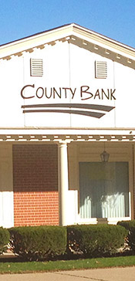
County Bank v. Shalla
20 N.W.3d 812 (Iowa 2025)
Shallas signed a note to borrow $1.3M from County Bank
  Goerdt brought a cashier’s check for $30,405.80 payable to People’s Bank. Goerdt instructed Shalla to cash the check with a specific teller at People’s Bank and deliver $25,000 to Goerdt in the parking lot of a Subway. Goerdt was later fired and indicted on 11 counts of fraud, identity theft, and other counts
Issue: Whether Iowa Code § 535.17 (credit agreement statute of frauds) bars negligence and fraudulent misrepresentation claims
Trial Court and Court of Appeals: Yes
Supreme Court: Yes – (1) promises and representations arising in connection with a credit agreement are part of the agreement, (2) the statute is interpreted and applied purposefully to ensure written proof of terms, and (3) the statute displaces exceptions under common law/equity

Slide 15

Hunter Three Farms, LLC v. Richard Hunter
18 N.W.3d 1 (Iowa 2025)
Farming brothers Robert, Gary, and Richard formed an LLC
Richard quietly submitted claim to Syngenta Corn Seed Settlement Program and received a $62,467.91 settlement
Richard deposited the settlement in bank account for “Hunter Iowa Farms, Inc.”
Robert and Gary learned on the settlement when Syngenta issued a Form 1099-MISC to the LLC

Slide 16

Hunter Three Farms, LLC v. Richard Hunter
18 N.W.3d 1 (Iowa 2025)
At issue: Whether a majority of the voting members of an LLC can authorize the company to file a suit against another voting member, without that member’s consent
Filed Statement of Authority: “A majority of the voting membership interests are authorized to make ordinary business decisions. All other decisions, including any change to this Statement of Authority, will require the consent of all members.”
  Immaterial: Statement of Authority affects only the power of a person to bind an LLC to persons that are not members
In the absence of an operating agreement, Iowa Code
§ 489.407(2)(d) requires consent of all members for actions outside “the ordinary course of the activities of the company”
  What constitutes ordinary course of activities?

Slide 17
Hunter Three Farms, LLC v. Richard Hunter
18 N.W.3d 1 (Iowa 2025)
Matters that fall outside of ordinary course of activities:
  Selling, leasing, exchanging, or otherwise disposing of all, or substantially all, of the company’s property.
  Iowa Code § 489.207(2)(d)
Held: Acts that require unanimity are those material to the ongoing operation of the company and thus material to the members’ respective interests in the company.
  Robert and Gary commenced an ordinary debt collection suit, which falls under ordinary course of activities

Slide 18

Degeneffe v. Home Pride Contractors, Inc.
16 N.W.3d 501 (Iowa 2025)
Degeneffes refused to pay Home Pride Contractors, Inc. for repairs from a hail storm, contending that the general contractor was a “storm chaser” because a sub completed the repairs
Home Pride commenced a collection action
Degeneffes filed a separate suit, alleging harassing and abusive collection efforts in violation of the Iowa Consumer Credit Code (Iowa Code § 537.7103(2)
  Dragging Degeneffes into Nebraska Court
  Calling Lance Degeneffe a criminal
  Accusing the Degeneffes of stealing from Home Pride
  Demanding attorney fees
This Photo by Unknown Author is licensed under CC BY

Slide 19
Degeneffe v. Home Pride Contractors, Inc.
16 N.W.3d 501 (Iowa 2025)
12. Default. Should default be made in payment of this agreement, charges shall be added from the date thereof at a rate of one and one-half (1-1/2) percent per month (18% per annum) or the maximum allowable by law on the remaining balance not paid, with a minimum charge of $2.00 per month, and if placed in the hands of an attorney for collection, all attorneys and legal filing fees shall be paid by customer accepting this agreement.
At issue: Whether the roofing contract was a “consumer credit sale” under the ICCC as defined by Iowa Code § 537.1301(13)(a)
A consumer credit sale is a sale of goods, services, or an interest in which all of the following are applicable:
  Credit is granted either pursuant to a seller credit card or by a seller who regularly engages as a seller in credit transactions of the same kind
  The buyer is a person other than an organization
  The goods, services, or interest in land are purchased primarily for a personal, family, or household purpose
  Either the debt is payable in installments or a finance charge is made
  With respect to a sale of goods or services, the amount financed does not exceed the threshold amount.

Slide 20
Degeneffe v. Home Pride Contractors, Inc.
16 N.W.3d 501 (Iowa 2025)
Iowa Code § 537.1301(16) defines “credit” as “the right granted by a person extending credit to defer payment of debt, incur debt and defer its payment, or to purchase property or services and defer payment therefor.”
Here: payment was due upon completion of work – default interest was a penalty and 30-day window before default interest was imposed was a forbearance (not a “time price differential”as concluded by the trial court)
This Photo by Unknown Author is licensed under CC BY

Slide 21
Degeneffe v. Home Pride Contractors, Inc.
16 N.W.3d 501 (Iowa 2025)
12. Default. Should default be made in payment of this agreement, charges shall be added from the date thereof at a rate of one and one-half (1-1/2) percent per month (18% per annum) or the maximum allowable by law on the remaining balance not paid, with a minimum charge of $2.00 per month, and if placed in the hands of an attorney for collection, all attorneys and legal filing fees shall be paid by customer accepting this agreement.
At issue: Whether the roofing contract was a “consumer credit sale” under the ICCC as defined by Iowa Code § 537.1301(13)(a)
A consumer credit sale is a sale of goods, services, or an interest in which all of the following are applicable:
   Credit is granted either pursuant to a seller credit card or
  by a seller who regularly engages as a seller in credit
  transactions of the same kind
   The buyer is a person other than an organization
   The goods, services, or interest in land are purchased
  primarily for a personal, family, or household purpose
   Either the debt is payable in installments or a finance
  charge is made
   With respect to a sale of goods or services, the amount
  financed does not exceed the threshold amount.

Slide 22

Bradshaw Renovations, LLC v. Graham
20 N.W.3d 479 (Iowa 2025)
Five-page itemization of materials and labor with lump sum charge for each stage of construction
  No labor rate or exclusion of profit margin
  Payment schedule
  Provisions for changes to scope of work
Final bill exceeded agreed upon changes by ~$20k
This Photo by Unknown Author is licensed under CC BY

Slide 23
Bradshaw Renovations, LLC v. Graham
20 N.W.3d 479 (Iowa 2025)
Jury awarded Grahams $16k for breach of contract and $40k in damages for consumer fraud claim and denied Bradshaw’s unjust enrichment/quantum meruit claims
  Court denied Bradshaw’s JNOV and awarded Grahams attorney fees – Court of Appeals affirmed
Grahams’ Consumer Fraud: Grahams relied solely on evidence of Bradshaw’s post hoc justification for requesting more than the costs specified in the contract. No evidence of misrepresentations that Grahams relied upon.
Bradshaw’s Unjust Enrichment and Quantum Meruit: Where a written contract exists, claims based upon an implied-in-fact contract cannot coexist on the same subject matter.
  An express contract supersedes an implied contract, and Bradshaw was seeking to recover for changes in the scope of work, which fell within the express terms of the written contract
This Photo by Unknown Author is licensed under CC BY
Notes:
Grahams walk away with $16,000 on their breach of contract claim.

Slide 24

Summit Carbon Solutions, LLC v. Kasischke
14 N.W.3d 119 (Iowa 2024)
Kasischke refused to allow Summit access to his land in Hardin County in the path of the pipeline in order to survey
Summit filed a petition for injunctive relief to compel access under Iowa Code § 479B.15
Kasischke counterclaimed with a facial challenge to Iowa Code
§ 479B.15 and alleged failure to satisfy notice requirements
  Alleged tenant who received no notice, but failed to produce any evidence of the tenant
  Later amended to deny Summit is a pipeline company within the meaning of Iowa Code § 479B.15
This Photo by Unknown Author is licensed under CC BY-SA

Slide 25

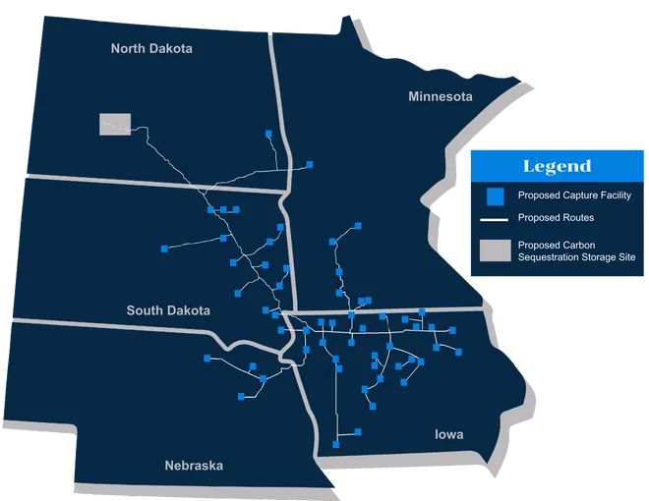
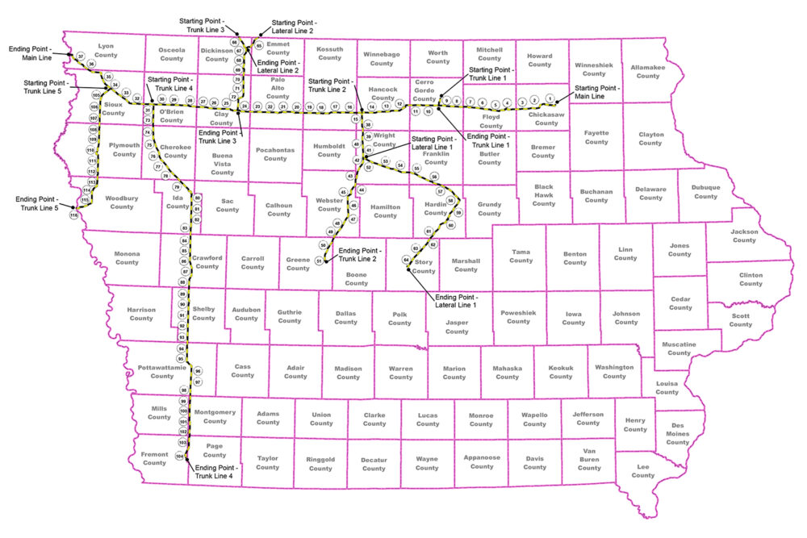
Summit Carbon Solutions, LLC v. Kasischke
14 N.W.3d 119 (Iowa 2024)

Slide 26
Summit Carbon Solutions, LLC v. Kasischke
14 N.W.3d 119 (Iowa 2024)
Trial Court: Enjoined Kasischke from interfering with Summit’s entry to survey under Iowa Code § 479B.15
Supreme Court:
  Facial Challenge: Iowa Code § 479B.15 is a lawful pre-existing limitation on Kasischke’s title to the land ~ takings challenge fails
  “Pipeline Company”: Kasischke’s own expert agreed that Summit would transport carbon dioxide in its supercritical, or “largely… liquid” state ~ Summit is a pipeline company under the statute
  Statutory Notice Requirements: Testimony was evasive and not credible ~ Kasischke received the requisite written notice
  Injunction: statute overrode equitable requirements of showing irreparable harm and substantial injury

Slide 27

LS Power Midcontinent, LLC v. State
21 N.W.3d 551 (Iowa 2025)
Iowa Code § 478.16 (2020) granted incumbent utility companies a first right of refusal (ROFR) that blocked a qualified nonresident transmission company from competing
Prior litigation (LS Power I, 988 N.W.2d 316 (Iowa 2023)) addressed constitutional challenge and competitors’ standing to challenge the statute
Incumbents now sought to lift district court’s permanent injunction to pursue 2022 transmissions projects (Tranche I) and contended they could proceed without competitive rebidding

Slide 28

LS Power Midcontinent, LLC v. State
21 N.W.3d 551 (Iowa 2025)
Issue: Whether the district court erred by enjoining MidAmerican, ITC, and IUB from taking further action in the 2022 Tranche I projects under the unconstitutional ROFR in Iowa Code § 478.16
  Could the district court retroactively enjoin the parties from participating in projects awarded before a final judicial determination that Iowa Code § 478.16 is unconstitutional
Supreme Court:
  Subject Matter Jurisdiction: states retain authority over the location and construction of electrical transmission lines; the constitutionality of the ROFR was within the court’s jurisdiction, as was the remedy for the constitutional violation
  Iowa Code § 478.16 was void ab initio
    Incumbents had no vested rights because they were on notice of LSP’s constitutional challenge since 2020, and no physical work was begun
  Affirmed permanent injunction under Iowa law
  Validity of the MISO variance is a matter for the FERC, but injunction stands

Slide 29

Thank You

