Slide 1
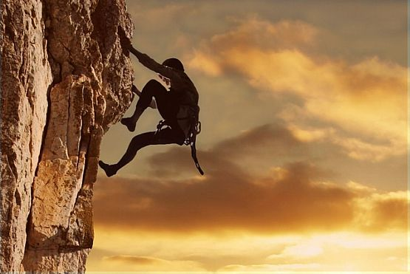
Scot G. Doyen Doyen Sebesta & Poelma Houston Austin Dallas
The Power of the 3 C’s

Slide 2
Conventional Wisdom for Lawyers
Educate your witness
Encourage your witness
Rehearse with your witness
Check witness’ social media
Help your witness focus
Discuss some case strategy
Tell the witness to be honest

Slide 3
How do we Typically Prep Our Witnesses
Be polite
Don’t guess or speculate
Say “I don’t know” or “I don’t recall” if appropriate
Give short answers
Don’t volunteer information
Remember you’re under oath
Don’t get combative

Slide 4
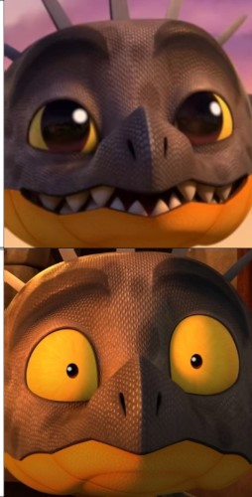
Do we Instill Confidence or Fear?

Slide 5
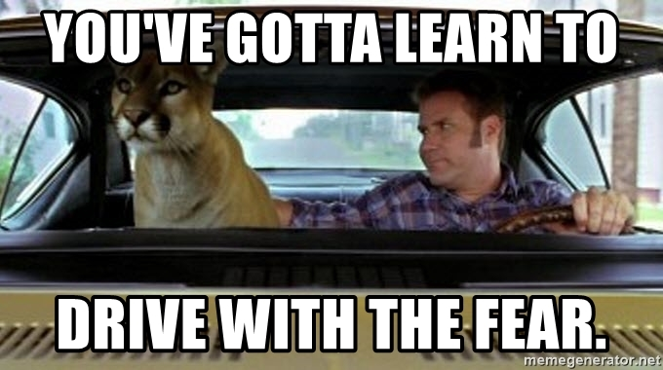
What our Objective Should Be

Slide 6
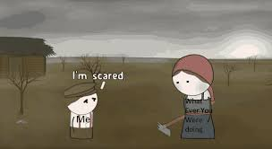
Even the Fear the Witness has not Reveleaed

Slide 7
Why Do Witnesses Fail?
Emotional Reaction
Threatened
Fight or Flight
Behavioral Reaction
Keep the neon in the tube
Mental Reaction
Stop responding and start reacting

Slide 8
We Must Empower our Witnesses to Respond and not React

Slide 9
Otherwise – We Might Get This:

Slide 10
We Must Empower by Education
We must tell the witness the accurate view of the current litigation environment
We must reassure the witness that they are actually in control
We must help them realize the significance of teaching the ACTUAL audience – the jury, not the questioner

Slide 11
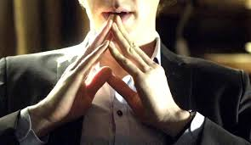
Purposes for Taking a Deposition
Size up the witness
Obtain damaging admissions
Explore new theories of the case
Confirm themes

Slide 12
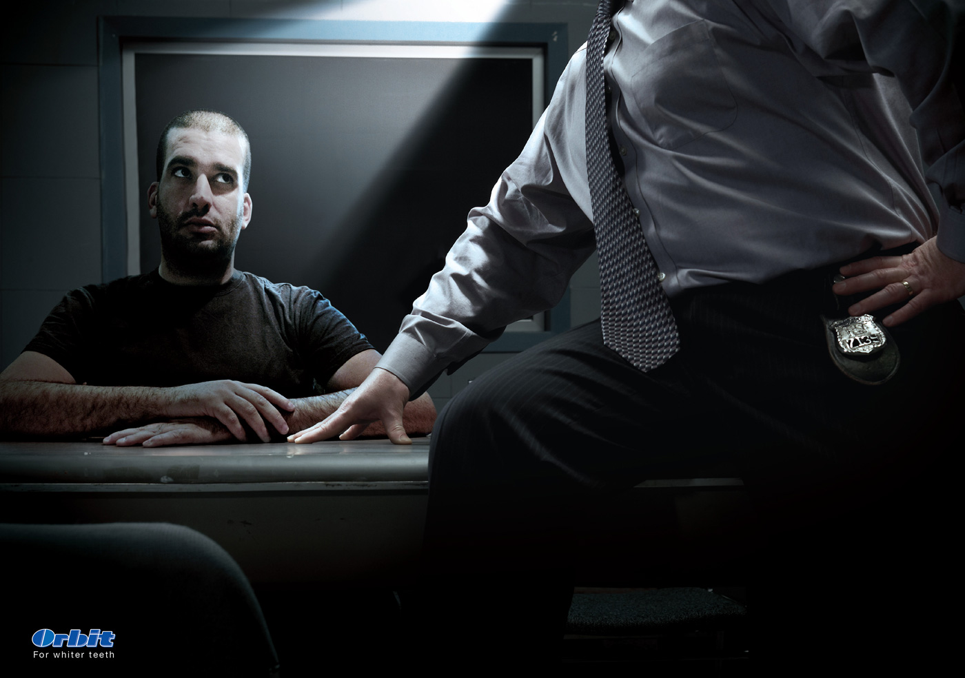
First, We Must Explain the Plaintiff’s Position
A deposition is a place where the plaintiff attorney hopes to get admissions or denials to prove his or her preconceived case
All deposition questions are formed from this perspective
A deposition is not a search for the truth
A deposition is not an interview or a conversation
It is an interrogation

Slide 17
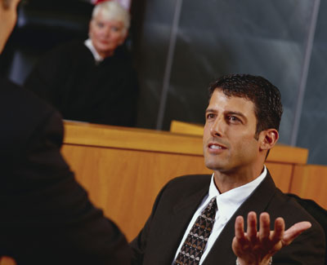
New Model for Witness Preparation
CHARACTER
CONTROL
COMMUNICATION

Slide 18
1. CHARACTER

Slide 19
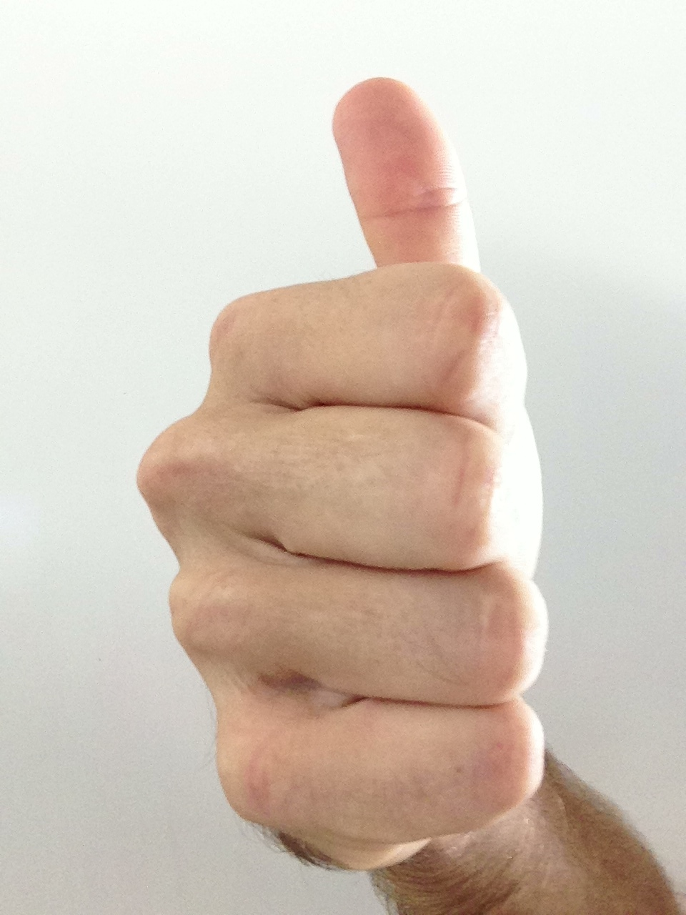
CHARACTER
Attitude is Everything

Slide 20
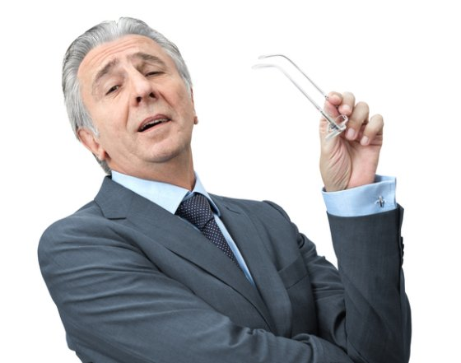
Undesirable Witness Qualities
Arrogant
Condescending
Defensive
Combative
Hostile/Angry
Uncertain
Inconsistent
Nitpicky
Overzealous
Unintelligible
Robotic
Confusing
Inappropriate
Slick
You get the picture

Slide 21
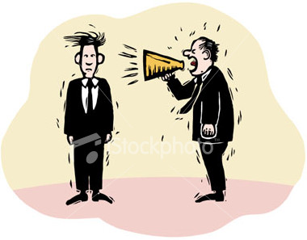
Message Communicated?
“I need to be right.”

Slide 22
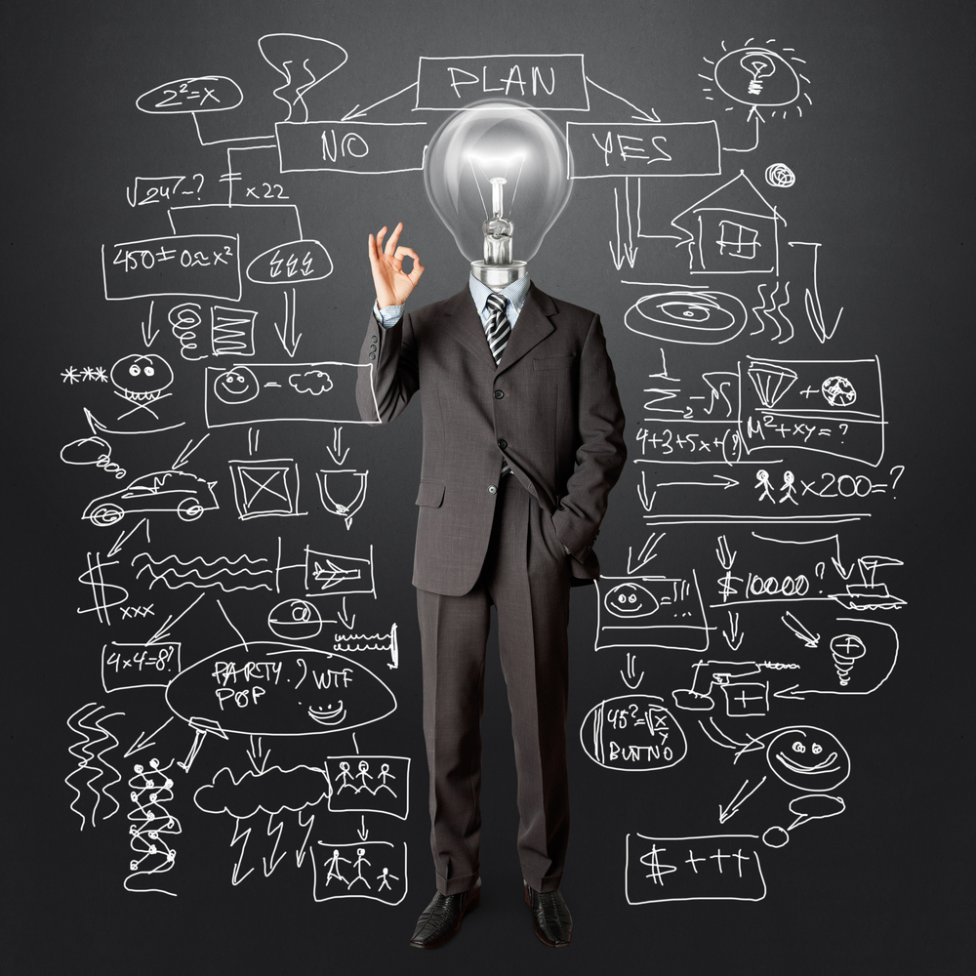
Desirable Witness Qualities
Objective
Personable
Courteous
Humble
Helpful
Educational
Credible
Clear
Consistent
Candid
Cooperative
Responsive
Honest
Authentic

Slide 23
Message Communicated?
“I want to help you understand.”

Slide 24
Primary Job of a Witness
To help others understand

Slide 25
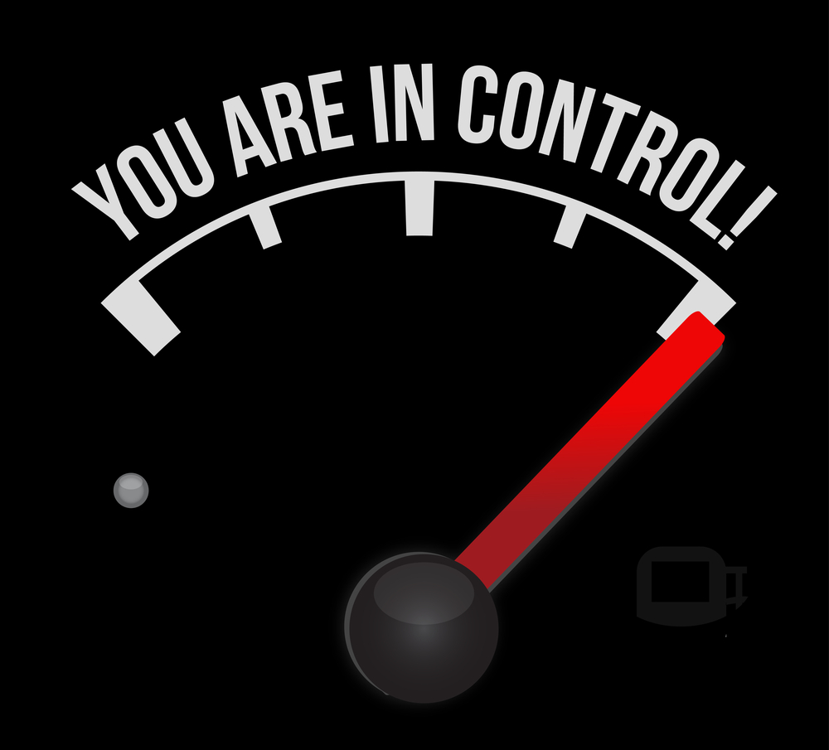
2. CONTROL

Slide 26
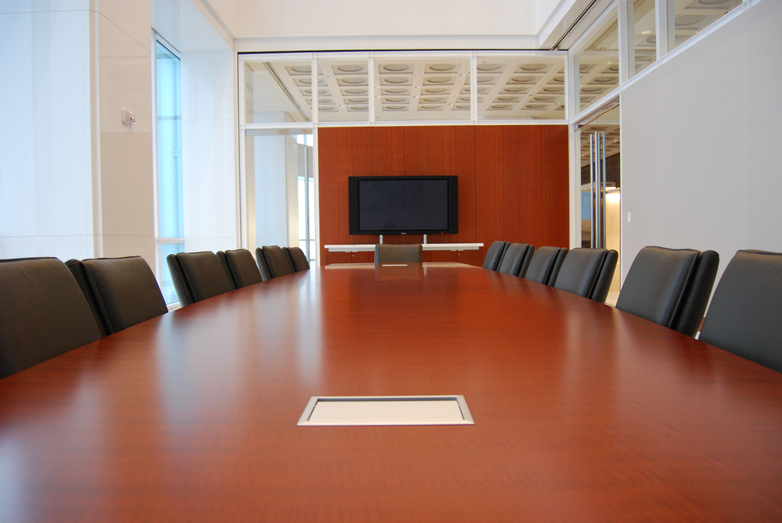
Control the Room
The witness is in control of the deposition
Without their information, it does not exist
Check the temperature, seating, lighting
Check camera angle, volume, screens
Have water in a cup to drink
Take breaks when you need them

Slide 27
Taking Charge of the Deposition
Controlling the tempo
Controlling the word choice
Controlling the attitude
Controlling the understanding of the questions

Slide 28
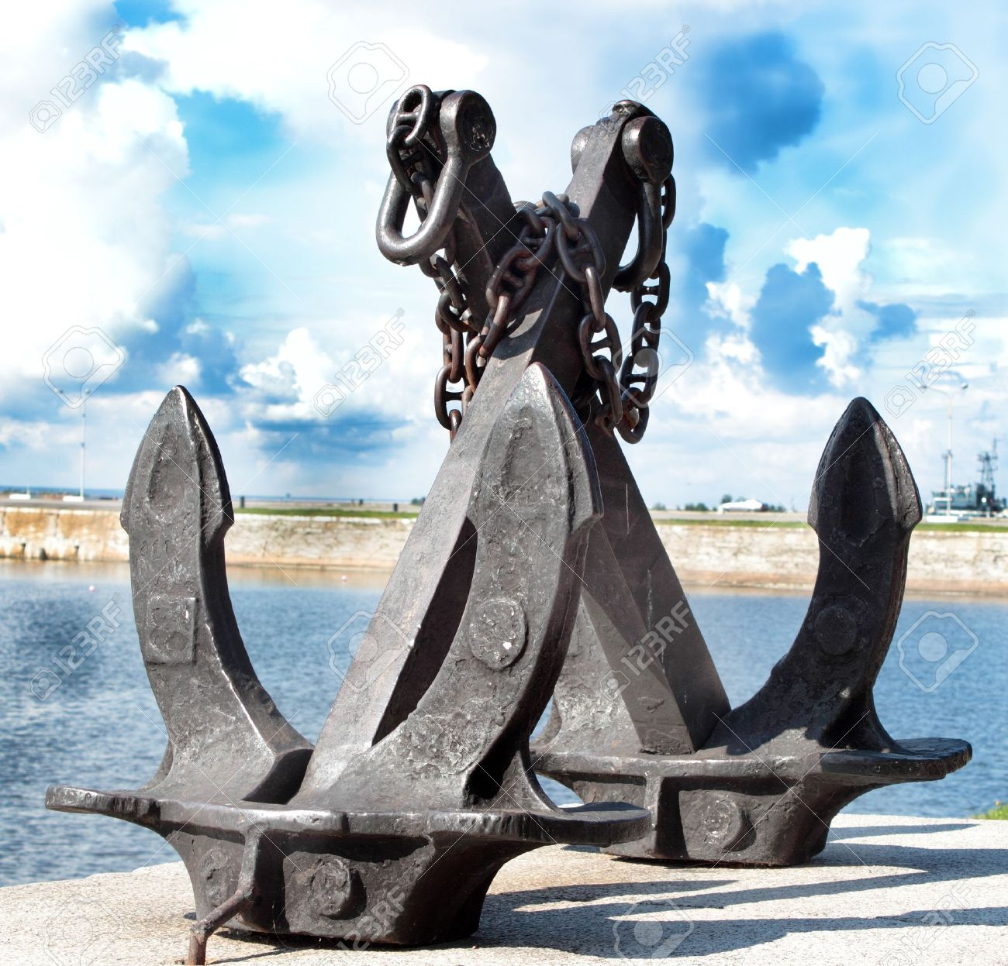
Anchors
“What do I know?”
“What did I do?”

Slide 29
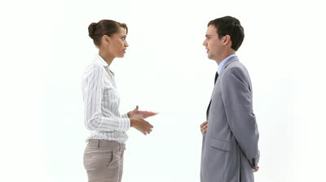
3. COMMUNICATE (Clarify)

Slide 30
Witness Listening Skills
PAUSE… Then Ask Yourself Three Questions:
1. “Do I understand the question?” or “What exactly am I being asked?”
2. “Am I the right person?” or “Do I have the information to answer it?”
3. “What is the most appropriate response?”
Don’t Anticipate: Only Listen to the Question Asked
Be Patient
Listen for Negative Framework

Slide 31
Questions to be Careful of:
Duties/Responsibilities
Company Policies
Customs and Practices
Guidelines and Rules
Legal Propositions
Absolutes (always, never, etc.)

Slide 32
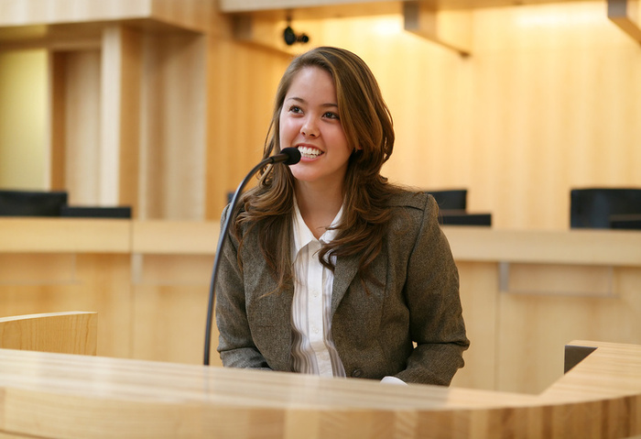
Witness Responsiveness
Use Your Own Words
Clarify & Educate
Qualify Yes/No Answers
Admit the Obvious
Breakdown and Address Question Parts
Admit Mistakes Lightly and With Confidence
Stay Within Personal Knowledge or Experience

Slide 33
Use Your Own Words
“Here is what I do…”
“Here is how I see that issue…”
“Here is how I think about that…”

Slide 34
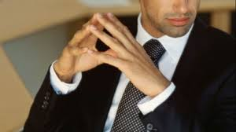
Testimony Demeanor
Dress and Groom Like You Do for Work
Assume You are Always Watched
Sit Forward
Make Eye Contact
Respond to Questioner, Include Jury
Use Documents and Exhibits to Educate
Use Strong Voice, Enunciate/Articulate
Breathe

Slide 35
Importance of Body Language*
Upper body position
Use of hands
Nervous gestures
Hands
Eyes
Lips
Head (looking up and down)
* Particularly important for video taped depositions.

Slide 36
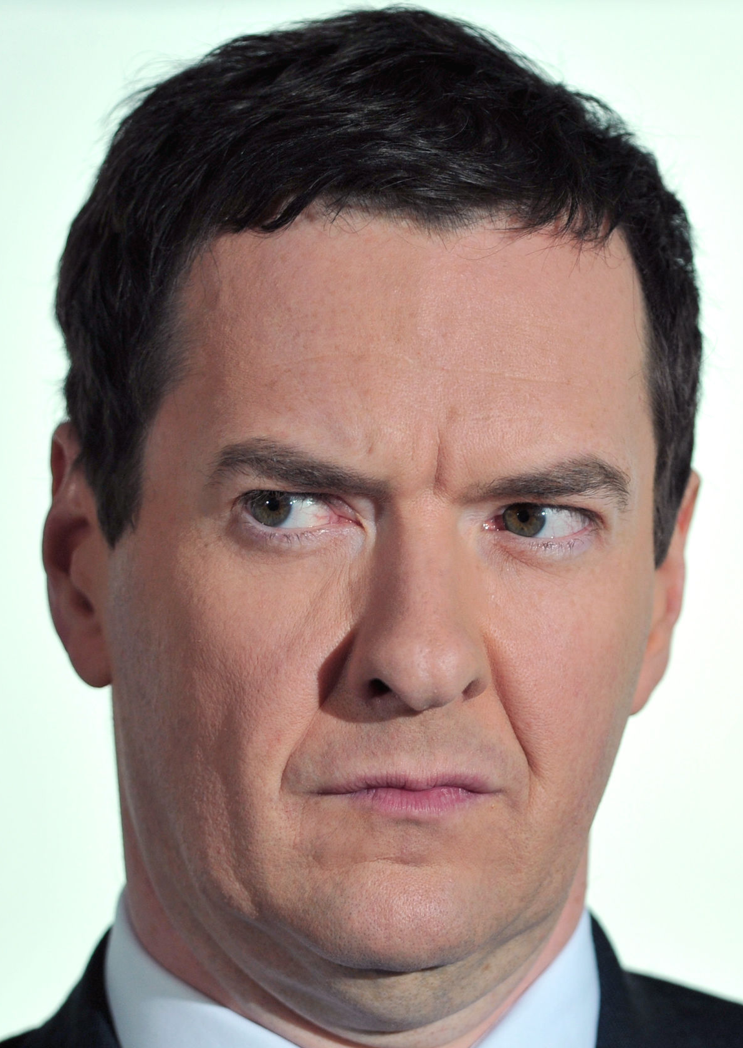
Counsel’s Tactics
Looks of disbelief, smirks, sighs
Intimidation
Silence after you answer
Raising voice
Cutting off your answer
Repetitious questions

Slide 37
Cross-Examination Question Types
Build-up/Agreement
Hypothetical
Compound
Embedded Assumptions
Accusations/ Condescension
Forced Admissions
Speeches or Narrative
Outside Area of Knowledge
Random/ Ambiguous/ General
Friendly/Open-ended
Nonverbal/Attitude
Repetition

Slide 38
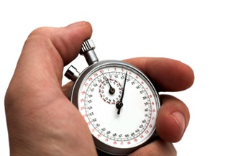
Witness Practice
Focus on 3 main points
Summarize your testimony in 5 sentences.
Use teaching visuals to anchor witness
Use documents to anchor
Videotape answers

Slide 39
Anchors
“What do I know?”
“What did I do?”

Slide 40
Primary Job of a Witness
To help others understand

Slide 41
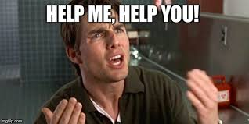
Primary Job of the Lawyer
To help the Witness
Time
Thought
Persuasion
Commitment

