Slide 1
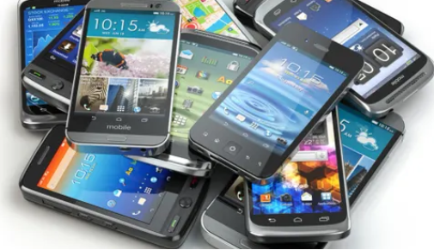
IOWA
Your Complete Digital Forensic Solution
515-829-1549
www.iaforensics.com
3209 Ingersoll Avenue Suite 208
Des Moines, IA 50312
515-829-1549

Slide 2
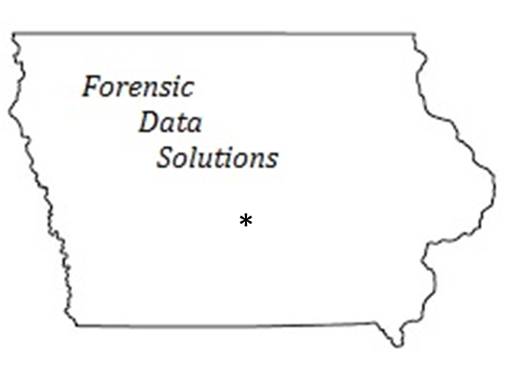
Who We Are
Des Moines based firm specializing in digital evidence analysis with over 24 years of experience.
We use only leading industry software and follow strict forensic processes.
We help you build your case with our customized easy to read reports.
We offer local litigation support

Slide 3
Background
Certified Cyber Crime Investigator
Certified Cyber Crime Examiner
Certified Economic Crime Forensic Investigator
Certified Cyber Crime Intelligence Analyst
Certified Forensic Investigator
Certified Ethical Hacker
Encase Computer Forensics l & ll with Enscript development
Encase Advanced Internet Examinations
Encase eDiscovery
Certified CompTIA A+
Certified CompTIA Net+
Certified CompTIA Security +
Microsoft Network Security
Microsoft Deploying, Implementing and Maintaining A.D.
Various Microsoft Software
Private Investigator License

Slide 4
Our Business Model
We Analyze & Support:
Cell Phones
Computers Windows & Macs
Servers/Logs
Cloud Storage
Email Recovery & Preservation
Social Media

Slide 5
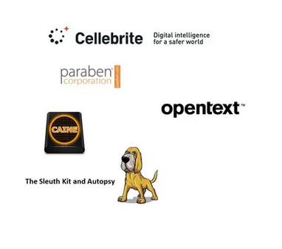
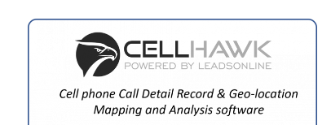
Forensic Software
Cellebrite - Cell phone investigative software used by law enforcement
EnCase - Computer Forensics
Sumuri (Mac Forensics)
Metaspike (Email Collection)
Net Analysis (Internet Activity)
CellHawk (Analyze Call Detail Records)

Slide 6
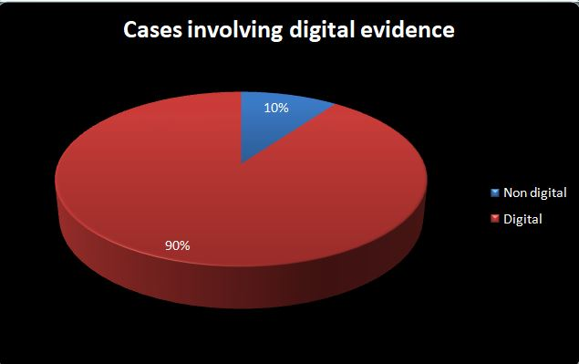
Understanding Digital Evidence For Todays Defense
Digital Evidence Can Be Complicated
Large Amounts of Data - Many Sources
Encompass Related and Unrelated Evidence
Identify Weaknesses - Incomplete
https://www.digitalinnocence.com

Slide 7
Defendable Items Re-Examination of Evidence
Lack of Proper Chain of Custody
Data Loss or Corrupted
Authenticity and Integrity of Digital Evidence
Proper Forensic Tools

Slide 8
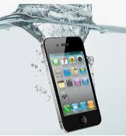
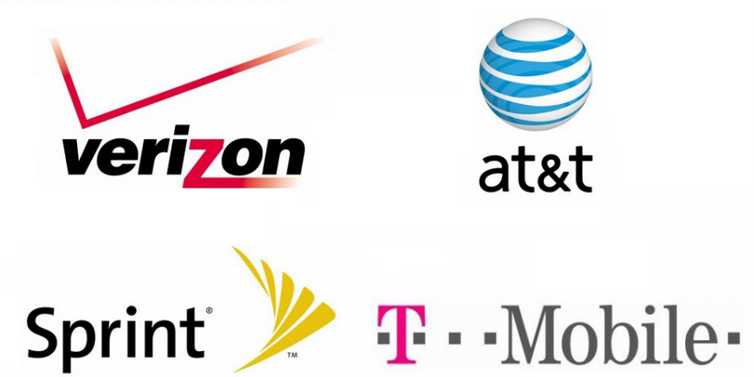
Importance Of Moving Quickly
User Impact
Missing/Deleted Information
Damaged or Lost/Stolen Devices
Traded or New Devices
Provider Retention
Text Message Life
Detailed Call Records
Social Media Retention Policies

Slide 9
We Scrutinize & Report
Authenticity/Reliability
Accuracy/Consistency
First Impressions
Corroboration Between Exhibits/ Checking Timestamps
Exculpatory Evidence

Slide 10
Building Your Case - A Comprehensive Picture
Pattern of Life
Contextualization
First Impressions Not Always Full Story
Not Complete/Contradicted By Additional Evidence
Timelines
Storyboards
Detail Explanations

Slide 11
We Take The Extra Steps In Cases 10 - Common Digital Evidence Sources
Exculpatory Evidence Revealed – Based on additional sources such as:
Cloud Services
Social Media Platforms
Network Traffic and Logs- Website Access Logs
Email Servers
External Storage Devices (USB Drives, External Hard Drives, SD Cards)
Digital Cameras and Surveillance Systems
Web Browsers and Search Engines
Encrypted Communication Platforms
CDR’s (detailed Call Records) for Comparison
Vehicle Infotainment and Telematics Systems
TOP 10

Slide 12
What Is New

Slide 13
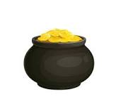
Three Levels of Extractions
Logical
Advanced Logical
Full File System
All About Access

Slide 14
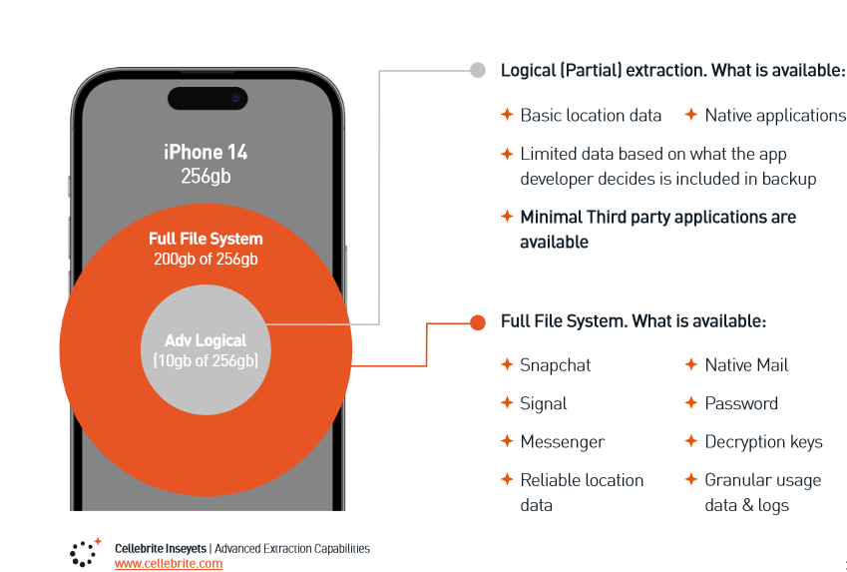
Extraction Comparisons

Slide 15
Level 1 & 2 Logical & Advanced Logical Extractions:
Level 1 & 2 Extractions Derived the Data From:
Device Backups
iTunes,
ADB Backup (Android)
**Not all the data and files on the device are extracted
Time Estimates
Extraction 4 – 6 Hours
Case Analysis 12-18 Hours

Slide 16
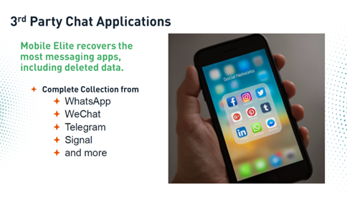
Level 3 Full File System (FFS) Extraction Most Comprehensive
User - Generated Content
System Files – Logs – Caches
Application Data & Metadata
Decrypt Chat Apps
Best Chance of Uncovering Hidden or Deleted Data
Time Estimates
Extraction 6 – 12 Hours
Case Analysis 20-30 Hours

Slide 17
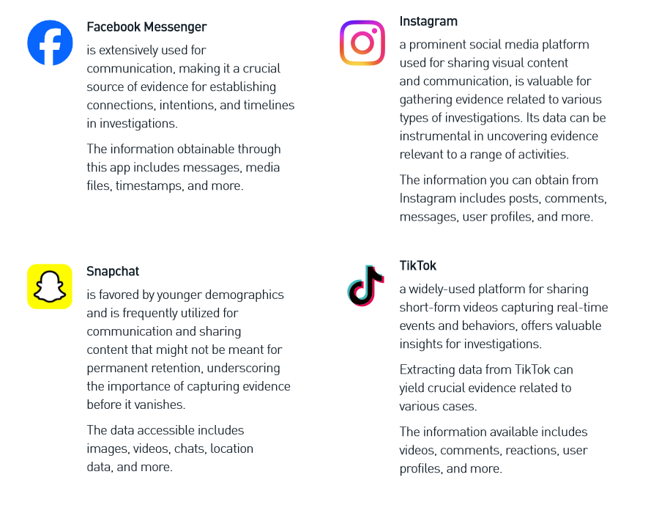
Examples of What You Can Gain With Access to FFS Data
Smartphone owners have approximately 80 Installed Apps

Slide 18
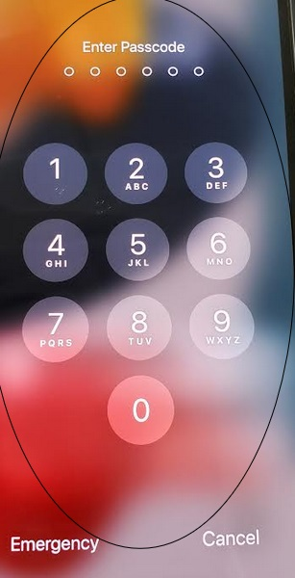
Cell Phone Unlock Capabilities
Additional Process
Pre-Approval
Protocols
Documents/Releases
It is important to note that Cellebrite’s access and extraction services are only available to authorized agencies and organizations. We have strict protocols in place to ensure that our services are used for legitimate purposes only and that user privacy is protected.

Slide 19
Cellebrite Forensic Software

Slide 20
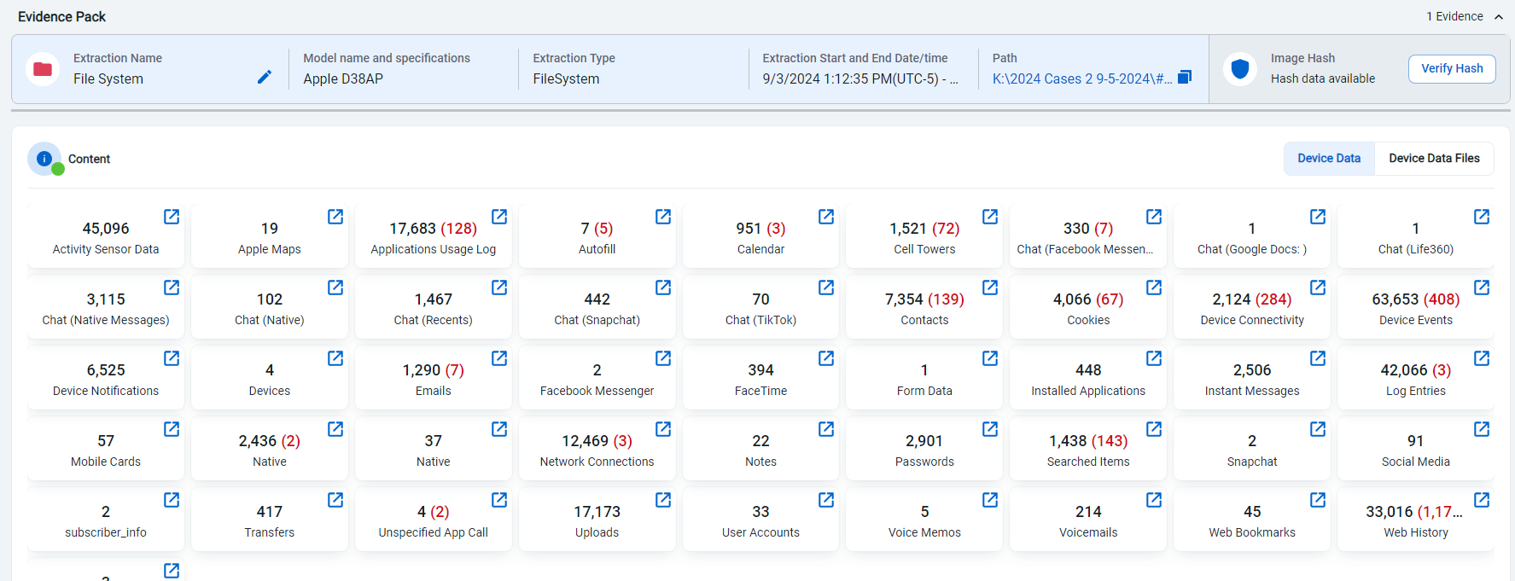
Cellebrite Content

Slide 21
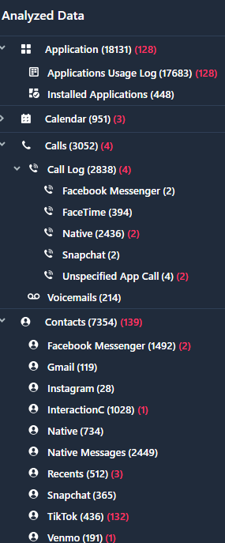
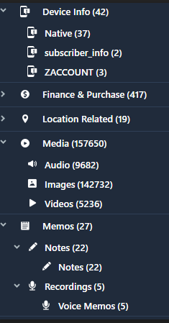
File Details
App Info
Device Info
Call Logs
Media
Images
Detailed Contact
Memos

Slide 22
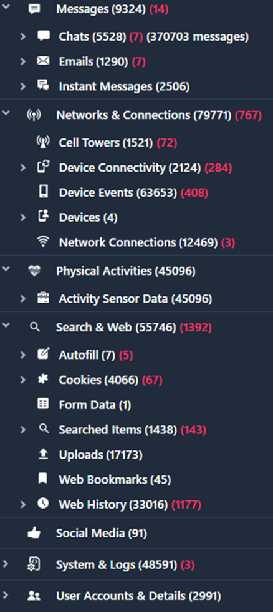
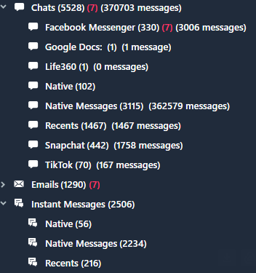
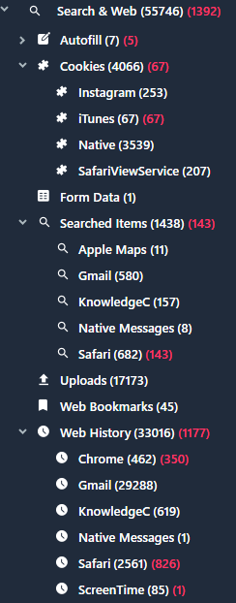
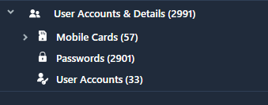
File Details
Message Details
Cookie Details
Network Info
Search Details
Search &Web
Web Details
Account Details

Slide 23
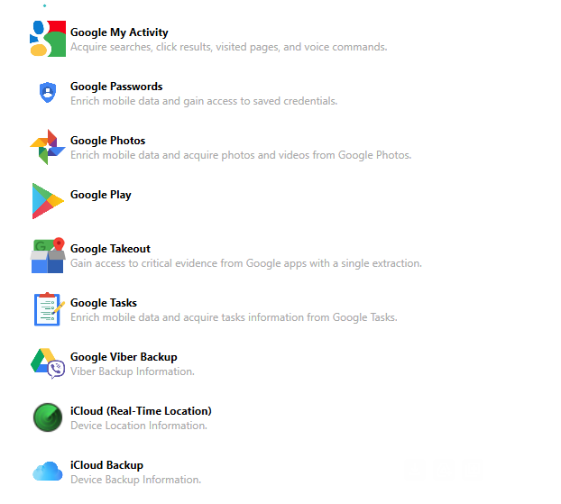
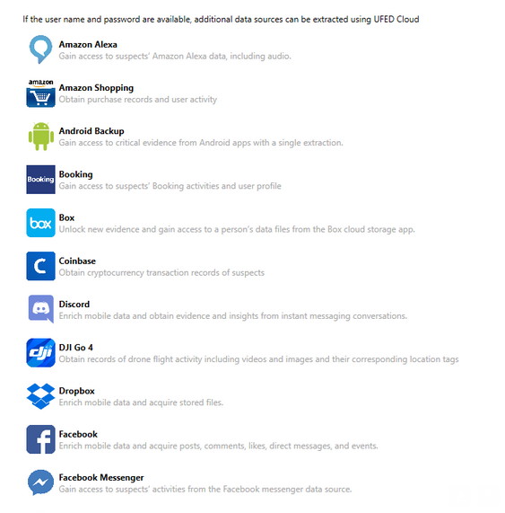
Cloud Access

Slide 24
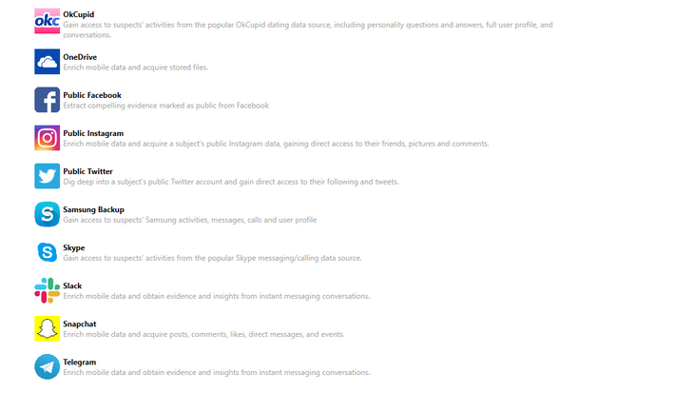
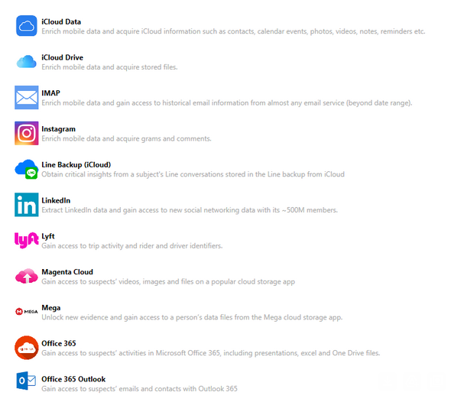
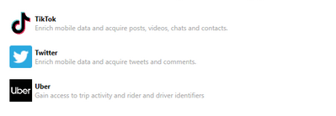
Cloud Access

Slide 25
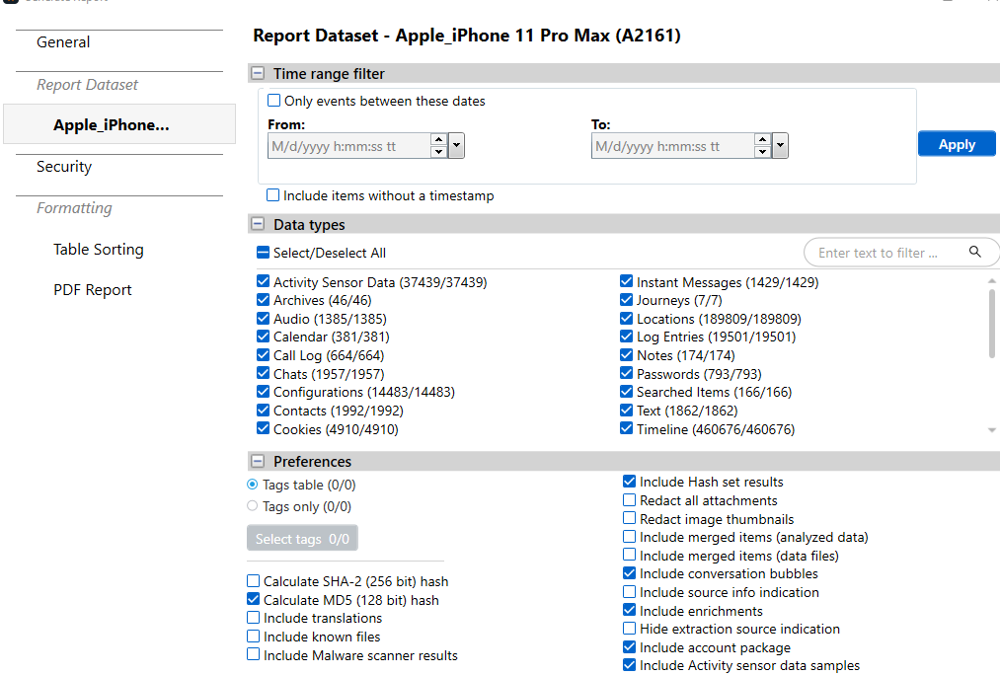
Custom Reporting

Slide 26
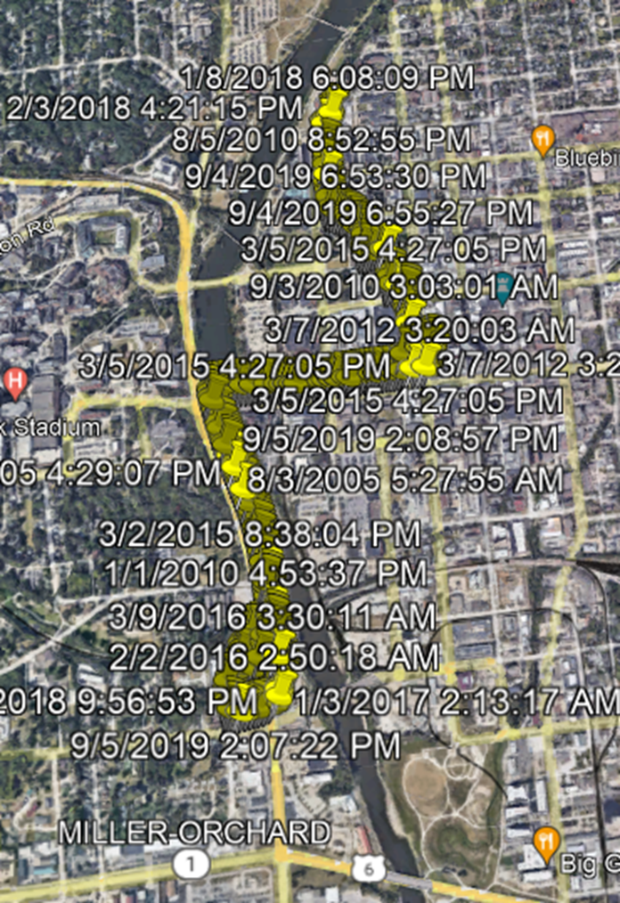
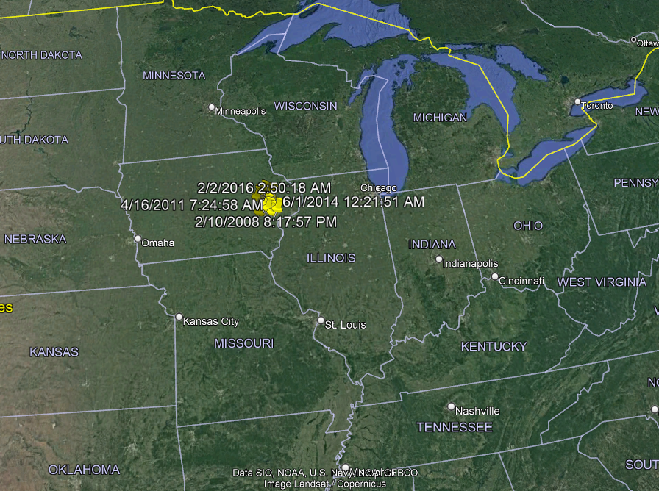
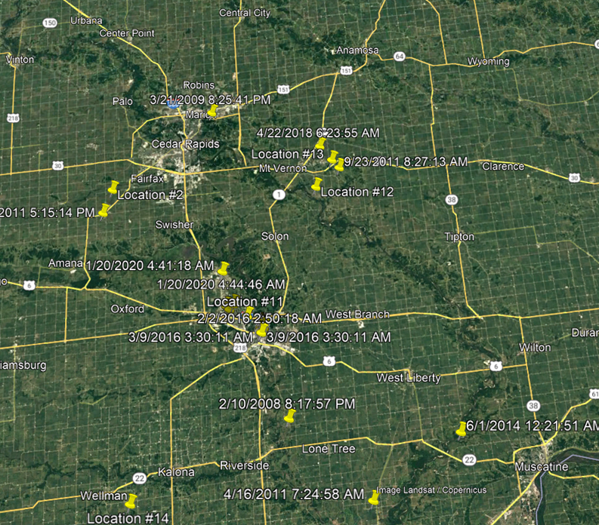
Map, Connect & Uncover Trends in Mobile Device Data
CellHawk is a web-based solution for analyzing and mapping Call Detail Records, geofence returns and practically any digital location evidence in your case.

Slide 27
Computer Forensics
We apply the scientific knowledge to legal problems.

Slide 28
Encase Forensic Suite
We use industry prove investigative tools.
EnCase® Forensic is the global standard in digital investigation technology for forensics.
The e-discovery and Digital Forensic industry has grown substantially
EnCase was first introduced in the late 1990’s - there is no tool has a more complete set of features than EnCase.
EnCase supports the broadest range of file systems and the examination of related artifacts.
It’s support for several industry standard encryption tools streamlines the acquisition process in encrypted environments.
https://www.opentext.com/products/encase-forensic

Slide 29
Computer Forensics
EnCase stores and presents evidence in a court approved format, resilient to scrutiny
and process, giving all those involved complete faith in the security of the investigation.
Industry Standard
Court-Accepted Evidence Format
Court-Validated:
Chain of Custody
Acquisition
Investigation Reporting
https://www.opentext.com/products/encase-forensic

Slide 30
Under The Hood
Here are some key types of computer forensics artifacts:
Windows Registry
Description: The Windows Registry is a database that stores configuration settings and options for the operating system and installed applications.
$Recycle.Bin (Windows) / Trash (Mac/Linux)
Description: These are folders where deleted files are temporarily stored before being permanently erased.
Event Logs
Description: Both Windows and Unix-based systems maintain logs of system, security, and application events.
Internet History and Cache
Description: Web browsers (Chrome, Firefox, Edge, etc.) store browsing history, cache files, and cookies.
Thumbs.db and IconCache.db (Windows)
Description: These are hidden system files that store thumbnail images of photos, videos, and documents.
USB Artifacts
Description: Artifacts related to the use of external USB devices (e.g., thumb drives, external hard drives).
Time Stamps (MAC Times)
Description: File systems store three important time stamps: Modified, Accessed, and Created times (often referred to as MAC times).
Link Files (.lnk)
Description: Windows creates shortcut (or link) files for recently opened documents, applications, or folders.

Slide 32
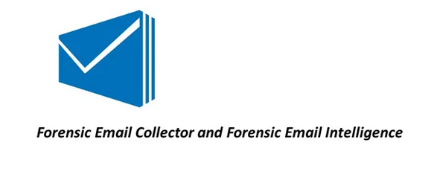
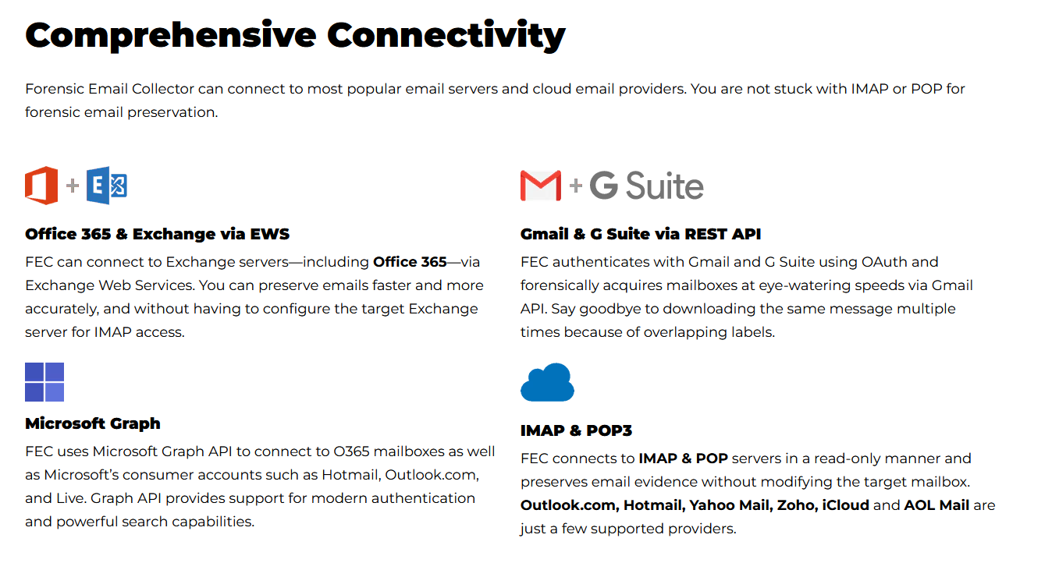
https://www.metaspike.com/forensic-email-collector

Slide 33
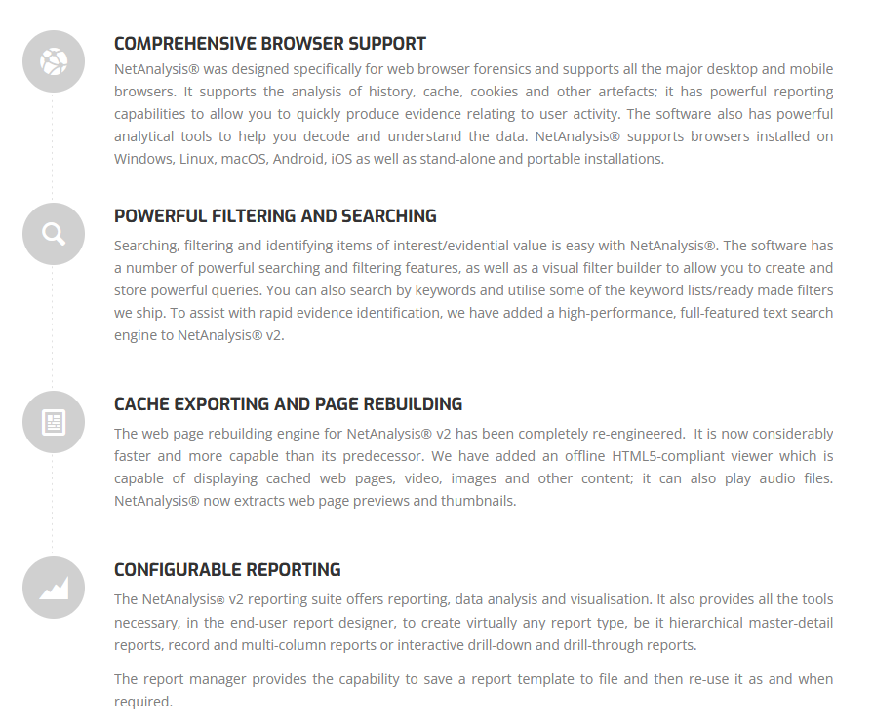
https://www.digital-detective.net

Slide 34
Final Thoughts

Slide 35
Digital Communications Inadvertently Compromised Privileged Status
Forwarding the communication to someone outside the attorney-client relationship may waive privilege, depending on the circumstances.
Text Messages Forwarded to Unrelated Parties.
Copying/Forwarding Emails - Adding attachments.
Good Practice Includes Emails With One Topic.
Avoiding Nonessential Recipients

Slide 36
Case Capabilities & Examples
Recourse For Investigations
Help Draft Request
Case Examples
Additional Associated Recourses Evaluated and Parsed
CDR’s - Google - Facebook etc..

Slide 37
Your Complete Digital Forensic Solution
Thank You
515-829-1549
www.iaforensics.com
3209 Ingersoll Avenue Suite 208
Des Moines, IA 50312
515-829-1549

